Slide 1
SQL (STRUCTURE QUERY LANGUAGE) OR Transact-SQL
Prepared By: Muniba Javaid

Slide 2
INTRODUCTION TO SQL
SQL is Structured Query Language, which is a computer language for storing, manipulating and retrieving data stored in a relational database.
SQL is the standard language for Relational Database System. All the Relational Database Management Systems (RDMS) like MySQL, MS Access, Oracle, Sybase, Informix, Postgres and SQL Server use SQL as their standard database language.

Slide 3
WHY SQL
SQL is widely popular because it offers the following advantages
Allows users to access data in the relational database management systems.
Allows users to describe the data.
Allows users to define the data in a database and manipulate that data.
Allows to embed within other languages using SQL modules, libraries & pre-compilers.
Allows users to create and drop databases and tables.
Allows users to create view, stored procedure, functions in a database.
Allows users to set permissions on tables, procedures and views.

Slide 4
Transcat- SQL
Transact-SQL is Microsoft's implementation of the standard SQL.
Usually referred to as T-SQL, this language implements a standardized way to communicate to the database.
The Transact-SQL language is an enhancement to SQL, the American National Standards Institute (ANSI) standard relational database language.
It provides a comprehensive language that supports defining tables, inserting, deleting, updating, and accessing the data in the table.

Slide 5
WHY TRANSCAT
Transact-SQL is a powerful language offering features such as data types, temporary objects, and extended stored procedures.
The Transact-SQL language in SQL Server provides improved performance, increased functionality, and enhanced features.

Slide 6
SQL COMMAND
The standard SQL commands to interact with relational databases are CREATE, SELECT, INSERT, UPDATE, DELETE and DROP. These commands can be classified into he following groups based on their nature
DDL - Data Definition Language
DML - Data Manipulation Language
DCL - Data Control Language

Slide 7
SQL DATA TYPES
A data type is an attribute defining the type of data that an object can contain.
Data types must be provided for columns, parameters, variables, and functions that
return data values, and stored procedures that have a return code.
Transact-SQL includes a number of base data types, such as varchar, text, and int.
All data that is stored in SQL Server must be compatible with one of the base data types.

Slide 8
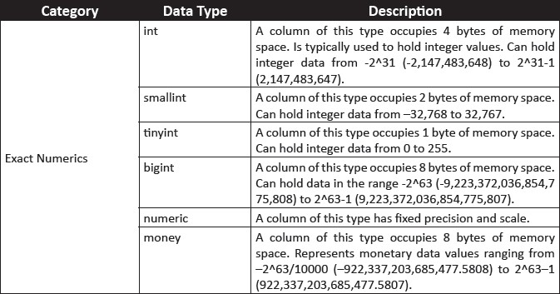
Cont….
System-defined Data Types
These data types are provided by SQL Server.
Following table shows the commonly used system-defined data types of SQL Server.

Slide 9
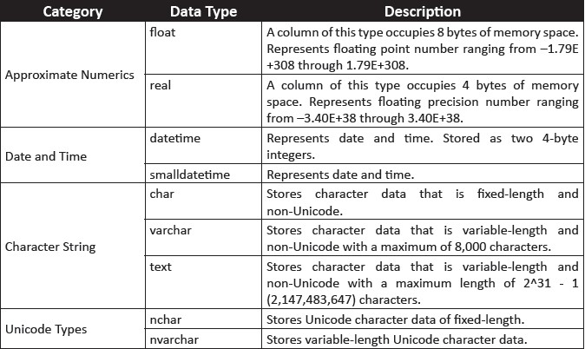
Cont….

Slide 10
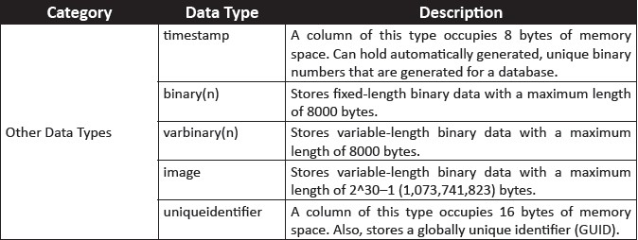
Cont….

Slide 11
Data definition language (DDL)
DDL actions are used to define and manage database objects.
Following are the DDL actions:
SNO | Command & Description
1 | CREATE Creates a new table, a view of a table, or other object in the database
2 | ALTER Modifies an existing database object, such as a table.
3 | DROP Deletes an entire table, a view of a table or other objects in the database

Slide 12
CREATE DATABASE AND TABLE COMMAND
The CREATE DATABASE statement is used to create a database
CREATE DATABASE database_name
The CREATE TABLE statement is used to create a table in a existing database.
CREATE TABLE table_name ( column_name1 data_type, column_name2 data_type, column_name3 data_type, .... )

Slide 13
Alter Table:
The ALTER TABLE statement is used to add, delete, or modify columns in an existing table.
1.To delete a column in a table:
ALTER TABLE table name DROP COLUMN column name
2.To change the data type of a column in a table:
ALTER TABLE table_name ALTER COLUMN column_name datatype
3.To add a column in a table:
ALTER TABLE table_name ADD column_name datatype

Slide 14
DROP COMMAND IN SQL
Drop command is used to remove an Object from a database.
When Drop Table command is used, it deletes all rows from that table, then removes the table from the database and removes all references to that table.
Syntax:
DROP TABLE Table_Name Ex: DROP TABLE Department

Slide 15
Data Manipulation language DML
DML is used for the following operations on data:
S – Select …….. > Queries
U - Update
I - Insert
D - Delete

Slide 16
Selecting Data
The select statement is used to query the database and retrieve selected data that match the criteria that you specify. Here is the format of a simple select statement:
SELECT * FROM Table1
The column names that follow the select keyword determine which columns will be returned in the results. You can select as many column names that you'd like, or you can use a "*" to select all columns.
SELECT Column1, Column2, Column3,
FROM Table1
The table name that follows the keyword from specifies the table that will be queried to retrieve the desired results.

Slide 17
Insert statement
The SQL INSERT INTO syntax has 2 main forms and the result of either of them is adding a new row into the database table.
INSERT INTO Table1 VALUES (value1, value2, value3…)
INSERT INTO Table1 (Column1, Column2, Column3…) VALUES (Value1, Value2, Value3…)

Slide 18
Update statements:
The SQL UPDATE clause changes the data in existing database row(s) .
SQL WHERE clause is used in our SQL UPDATE statement in order to specify which row(s) we intend to update.
UPDATE Table1 SET Column1 = Value1, Column2 = Value2 WHERE Some_Column = Some_Value

Slide 19
CUSTOMER TABLE:
FirstName | LastName | Email | DOB | Phone
John | Smith | John.Smith@yahoo.com | 2/4/1968 | 626 222-2222
Steven | Goldfish | goldfish@fishhere.net | 4/4/1974 | 323 455-4545
Paula | Brown | pb@herowndomain.org | 5/24/1978 | 416 323-3232
James | Smith | jim@supergig.co.uk | 20/10/1980 | 416 323-8888
UPDATE Customers
SET Phone = '626 555-5555' WHERE LastName = 'Smith'
FirstName | LastName | Email | DOB | Phone
John | Smith | John.Smith@yahoo.com | 2/4/1968 | 626 555-5555
Steven | Goldfish | goldfish@fishhere.net | 4/4/1974 | 323 455-4545
Paula | Brown | pb@herowndomain.org | 5/24/1978 | 416 323-3232
James | Smith | jim@supergig.co.uk | 20/10/1980 | 626 555-5555

Slide 20
Remember
If we don’t specify a WHERE clause in the SQL expression above, all customers' PHONE will be updated to ‘'626 555-5555 ', so be careful with the SQL UPDATE command usage.

Slide 21
Delete statement:
SQl DELETE command is used to remove data from a database.
The SQL DELETE command has the following generic SQL syntax:
DELETE FROM Table1 WHERE Some_Column = Some_Value

Slide 22
CUSTOMER TABLE:
FirstName | LastName | Email | DOB | Phone
John | Smith | John.Smith@yahoo.com | 2/4/1968 | 626 222-2222
Steven | Goldfish | goldfish@fishhere.net | 4/4/1974 | 323 455-4545
Paula | Brown | pb@herowndomain.org | 5/24/1978 | 416 323-3232
James | Smith | jim@supergig.co.uk | 20/10/1980 | 416 323-8888
DELETE FROM Customers WHERE LastName = 'Smith'
FirstName | LastName | Email | DOB | Phone
Steven | Goldfish | goldfish@fishhere.net | 4/4/1974 | 323 455-4545
Paula | Brown | pb@herowndomain.org | 5/24/1978 | 416 323-3232

Slide 23
Truncate Command in SQL:
Truncate Command is used to delete all the records from a table and frees the space in disc. Syntax: TRUNCATE TABLE Table_Name Ex: TRUNCATE TABLE Department

Slide 24
Difference between Delete and Truncate Command:
Delete Command deletes records from a table based on a condition or deletes all the records if no condition is specified. But it doesn't free the space.
Truncate Command deletes all the records from a table as well as frees up the space.

Slide 25
Difference between Drop and Truncate Command in SQL:
Truncate Command removes all rows from a table, but the table structure, all relationships, constraints remain in the Database.
Drop Command removes the entire table, all relationships associated with that table, all constraints in that table.
We can insert new records in a truncated table. But it is not possible when a table is dropped as it doesn't exist.

Slide 26
CONSTRAINTS

Slide 27
OBJECTIVES
Constraints
Types of Constraints
NULL/ Not NULL
Default
Unique
Primary Key
Foreign Key
Check

Slide 28
Rules for data
Tell you what type of data can go into a table
Prevent you from storing incorrect data: you can maintain data integrity.
Applied at column level and table level
Can have one or more columns in a constraints.

Slide 29
NULL/ NOT NULL CONSTRAINT
Null empty or missing value
Null does not mean space or blank.
Not Null means column does not accept null values i-e It must have values.
Specify only at column level.
While creating a table, Null is default for a column

Slide 30
NOT NULL SYNTAX
CREATE TABLE Persons ( ID int NOT NULL, LastName varchar(255) NOT NULL, FirstName varchar(255) NOT NULL, Age int );
SQL NOT NULL on ALTER TABLE
To create a NOT NULL constraint on the "Age" column when the "Persons" table is already created, use the following SQL:
Alter table persons
Alter column Age int not null default (17)

Slide 31
DEFAULT CONSTRAINT
The DEFAULT constraint is used to set a default value for a column.
The default value will be added to all new records, if no other value is specified
CREATE TABLE Persons ( ID int NOT NULL, LastName varchar(255) NOT NULL, FirstName varchar(255), Age int, City varchar(255) DEFAULT 'Sandnes' );
The DEFAULT constraint can also be used to insert system values, by using functions like GETDATE():
CREATE TABLE Orders ( ID int NOT NULL, OrderNumber int NOT NULL, OrderDate date DEFAULT GETDATE() );

Slide 32
Alter default
Alter default ADD Command
ALTER TABLE Persons ADD CONSTRAINT df_City DEFAULT 'Sandnes' FOR City;
Alter Unique Drop Command
alter table persons drop constraint DF__Persons__city__35BCFE0A;
alter table Persons drop column city

Slide 33
UNIQUE CONSTRAINT
Ensure all values in a column are unique.
Can have multiple columns in a UNIQUE constraint.
Can be applied on a NULL column but only one column can be NULL
Can have multiple UNIQUE constraints per database table.
Defined at column or table level.

Slide 34
UNIQUE SYNTAX
CREATE TABLE Persons ( ID int NOT NULL UNIQUE, LastName varchar(255) NOT NULL, FirstName varchar(255), Age int );
Alter Unique ADD Command
Alter table Student3
Add constraint myunique UNIQUE(std_id)
Alter Unique DROP Command
alter table student3 drop constraint myunique
Alter table student3 drop column std_id

Slide 35
PRIMARY KEY
The PRIMARY KEY constraint uniquely identifies each record in a table.
Primary keys must contain UNIQUE values, and cannot contain NULL values.
A table can have only ONE primary key; and in the table, this primary key can consist of single or multiple columns (fields).
create table customer(
ID int Primary key,
Name varchar (225),
Age int not null,
Address char (225)
)

Slide 36
ALTER PRIMARY KEY
--Exsisting table column to convert primary key
Alter Primary Key ADD Command
alter table customer add PRIMARY KEY(ID)
alter table customer Add Constraint Pk_custID PRIMARY KEY (ID);
Alter Primary Key Drop Command
Alter table customer Drop constraint PK__customer__3214EC274A5A5518
Alter table customer drop column ID

Slide 37
FOREIGN KEY
A FOREIGN KEY is a field (or collection of fields) in one table, that refers to the PRIMARY KEY in another table.
The table with the foreign key is called the child table, and the table with the primary key is called the referenced or parent table.
Foreign key constraints are used to enforce referential integrity.
create table customer2 (cust_id int primary key, name varchar (225));
create table orderr (Order_ID int primary key, item varchar (225) not null,
cust_id int Foreign key References customer2 (cust_id))

Slide 38
ALTER FOREIGN KEY
--Exsisting table column to convert Foreign key
Alter Foreign Key ADD Command
alter table orderr
add constraint FK_custID FOREIGN KEY(cust_id) References customer2 (cust_id)
Alter Foreign Key Drop Command
alter table orderr drop constraint FK__orderr__cust_id__5070F446
alter table orderr drop column cust_id

Slide 39
CHECK CONSTRAINT
The CHECK constraint is used to limit the value range that can be placed in a column.
If you define a CHECK constraint on a column it will allow only certain values for this column.
If you define a CHECK constraint on a table it can limit the values in certain columns based on values in other columns in the row.

Slide 40
ALTER CHECK CONSTRAINT
--Exsisting table column to convert Foreign key
Alter Check Constraint ADD Command
alter table EMP_PhoneExpenses add constraint CK_Uni Check (Amount >10)
Alter Check Constraint Drop Command
alter table EMP_PhoneExpenses drop column Amount
alter table EMP_PhoneExpenses drop constraint CK__EMP_Phone__Amoun__24927208

Slide 41
SQL SELECT STATEMENT USE

Slide 42
SQL CLAUSE

Slide 43
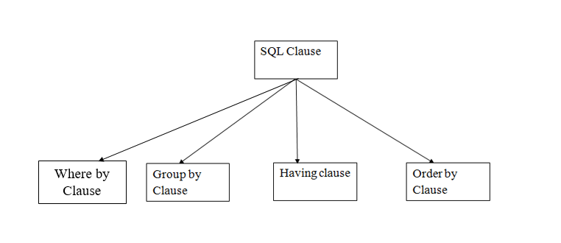
SQL CLAUSES
SQL clause helps us to retrieve a set or bundles of records from the table.
SQL clause helps us to specify a condition on the columns or the records of a table.

Slide 44
WHERE CLAUSE

Slide 45
DEFINITION
The WHERE clause is used to filter records.
It is used to extract only those records that fulfill a specified condition.
WHERE SYNTAX
SELECT column1, column2, ... FROM table_name WHERE condition;
Note: The WHERE clause is not only used in SELECT statements, it is also used in UPDATE, DELETE, etc.!
Where clause is used with different operators in select, update and delete statements

Slide 46
OPERATORS IN SQL
There are different types of operators in SQL Language. We will use two types of operators with where clause
Comparison Operator
Logical Operator

Slide 47
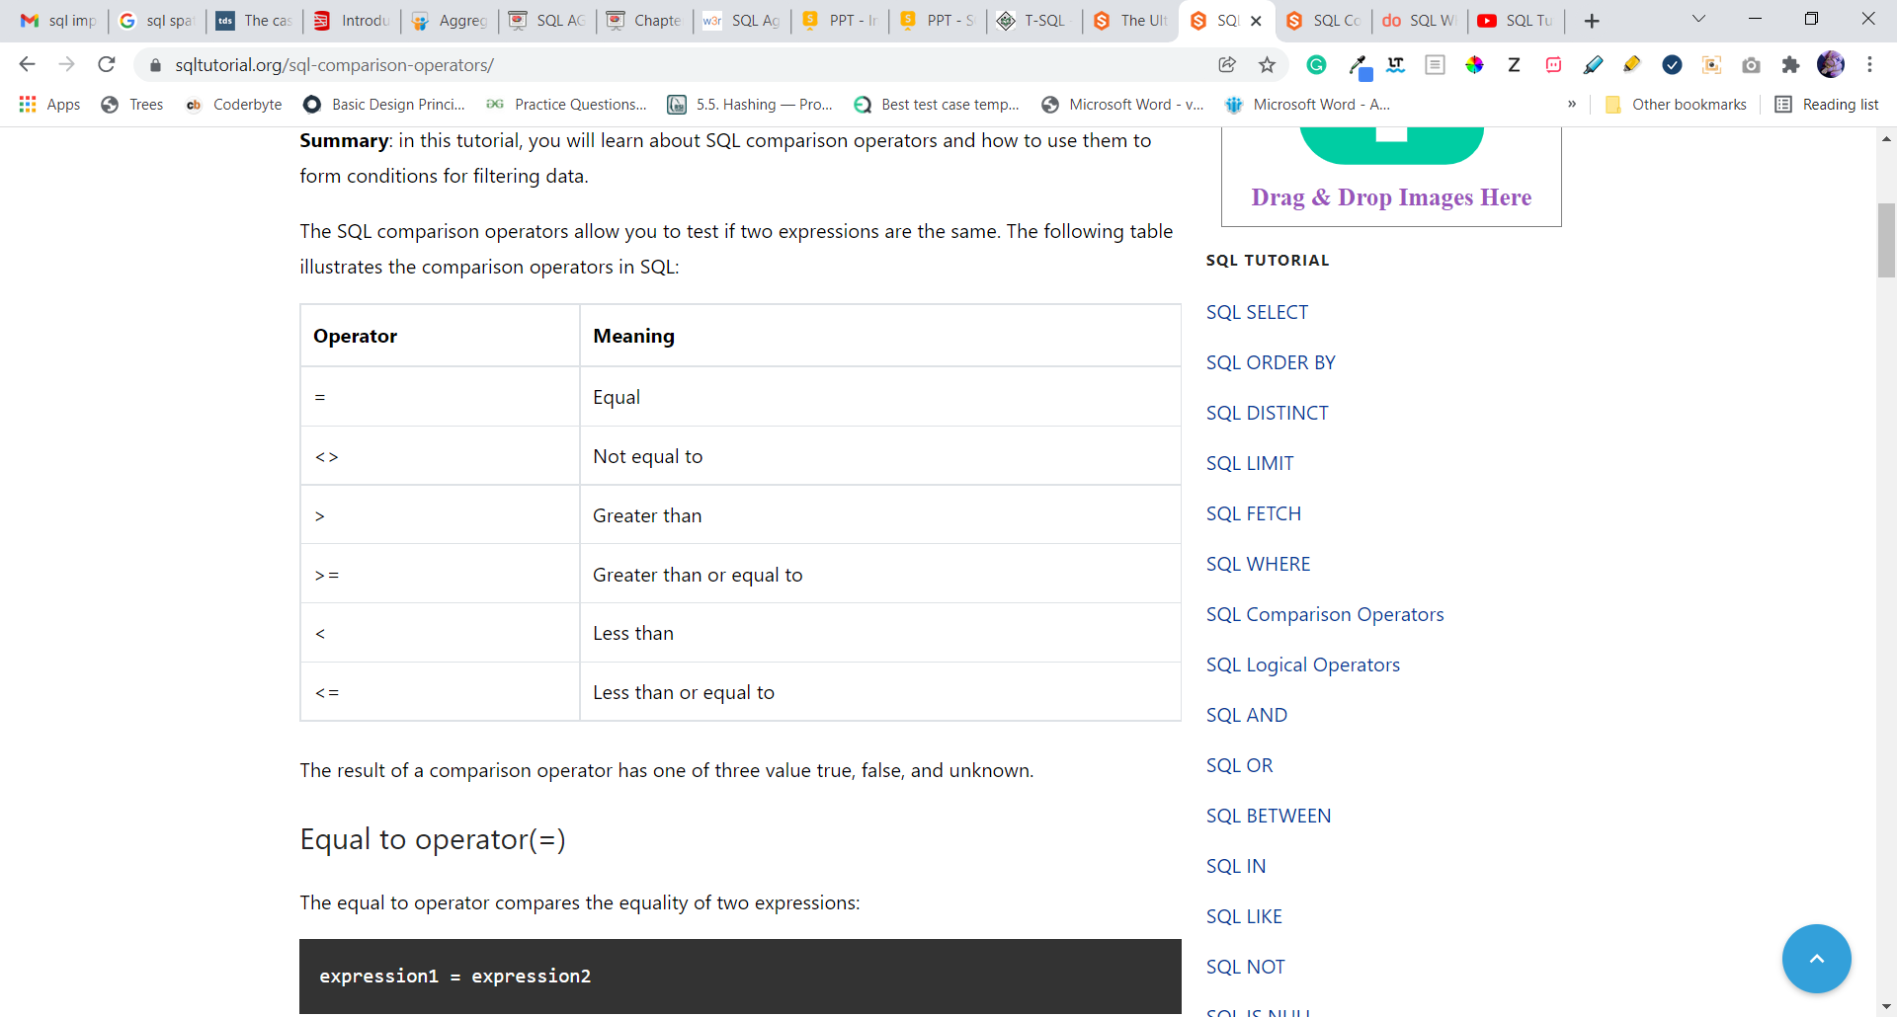
Comparison Operator
The SQL comparison operators allow you to test if two expressions are the same. The following table illustrates the comparison operators in SQL:

Slide 48
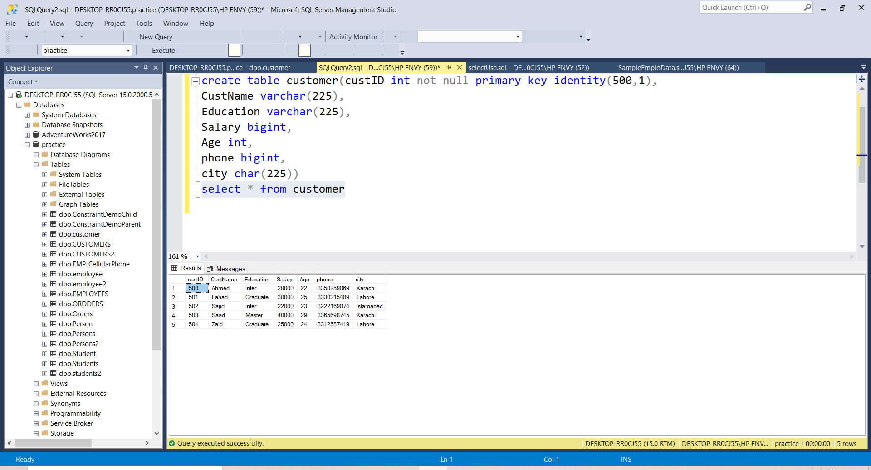
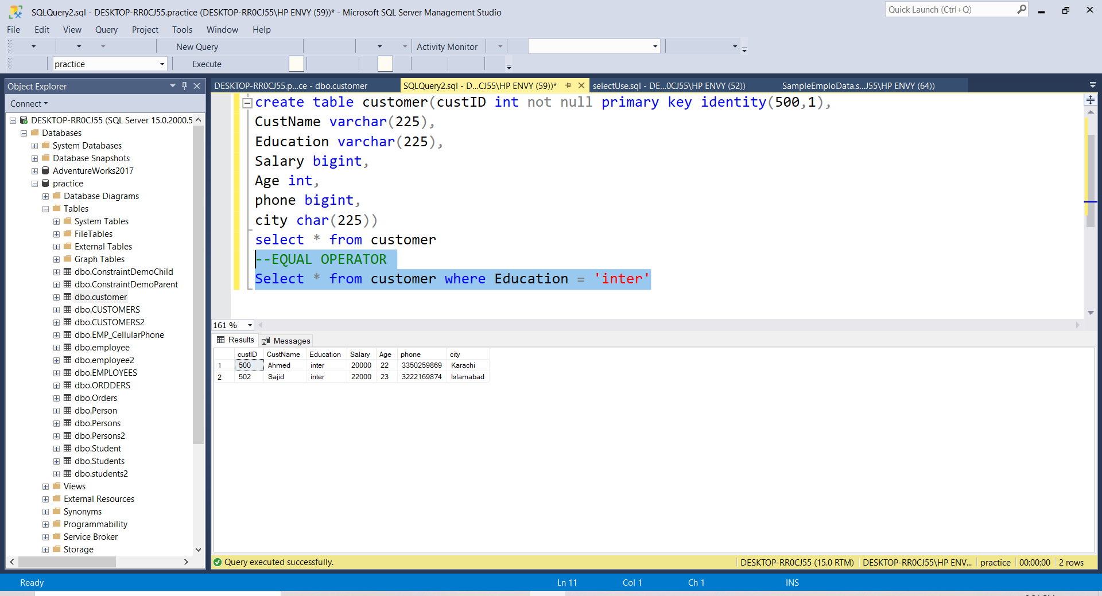
Equal to operator(=)
The equal to operator compares the equality of two expressions:
For Example Customer Table
--EQUAL OPERATOR QUERY
Select * from customer where Education = 'inter'

Slide 49
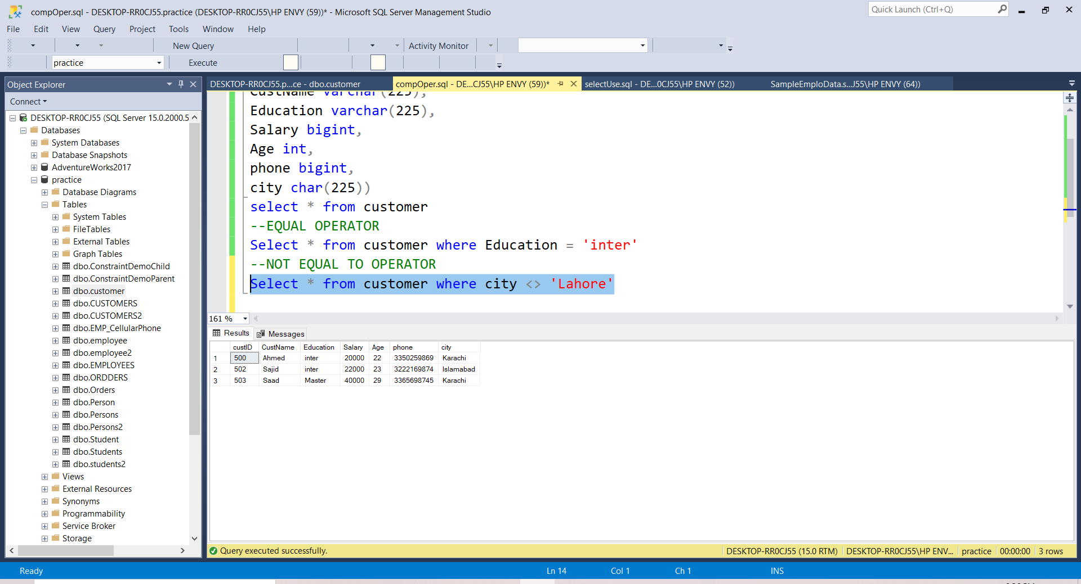
NOT Equal to operator(<>)
The not equal to (<>) operator compares two non-null expressions and returns true if the value of the left expression is not equal to the right one; otherwise, it returns false.
For Example Customer Table
--NOT EQUAL TO OPERATOR
Select * from customer where city <> 'Lahore'

Slide 50
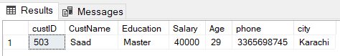
Greater Than Operator(>)
The greater than operator (>) compares two non-null expressions and returns true if the left operand is greater than the right operand; otherwise, the result is false.
For Example Customer Table
--GREATER THAN OPERATOR
Select * from customer where age > 25

Slide 51
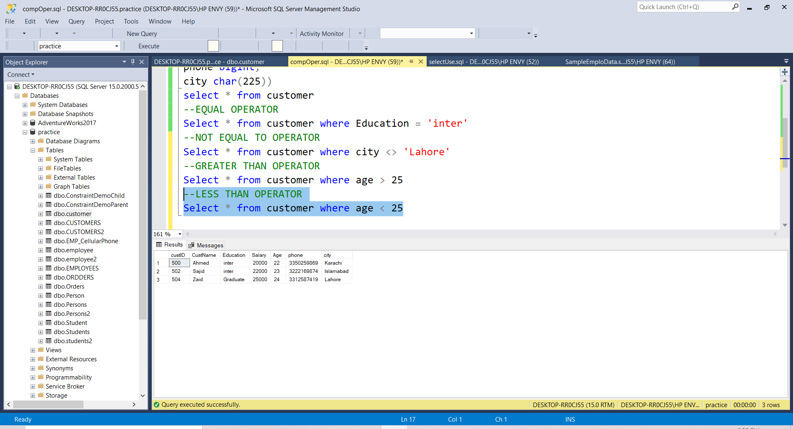
Less Than Operator(<)
The less than operator compares two non-null expressions. The result is true if the left operand evaluates to a value that is lower than the value of the right operand; otherwise, the result is false.
For Example Customer Table
--LESS THAN OPERATOR
Select * from customer where age < 25

Slide 52
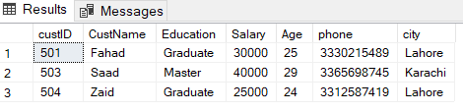
Greater Than Equal Operator(>=)
The greater than or equal operator (>=) compares two non-null expressions. The result is true if the left expression evaluates to a value that is greater than the value of the right expression.
For Example Customer Table
--GREATER THAN EQUAL OPERATOR
Select * from customer where Salary >= 25000

Slide 53
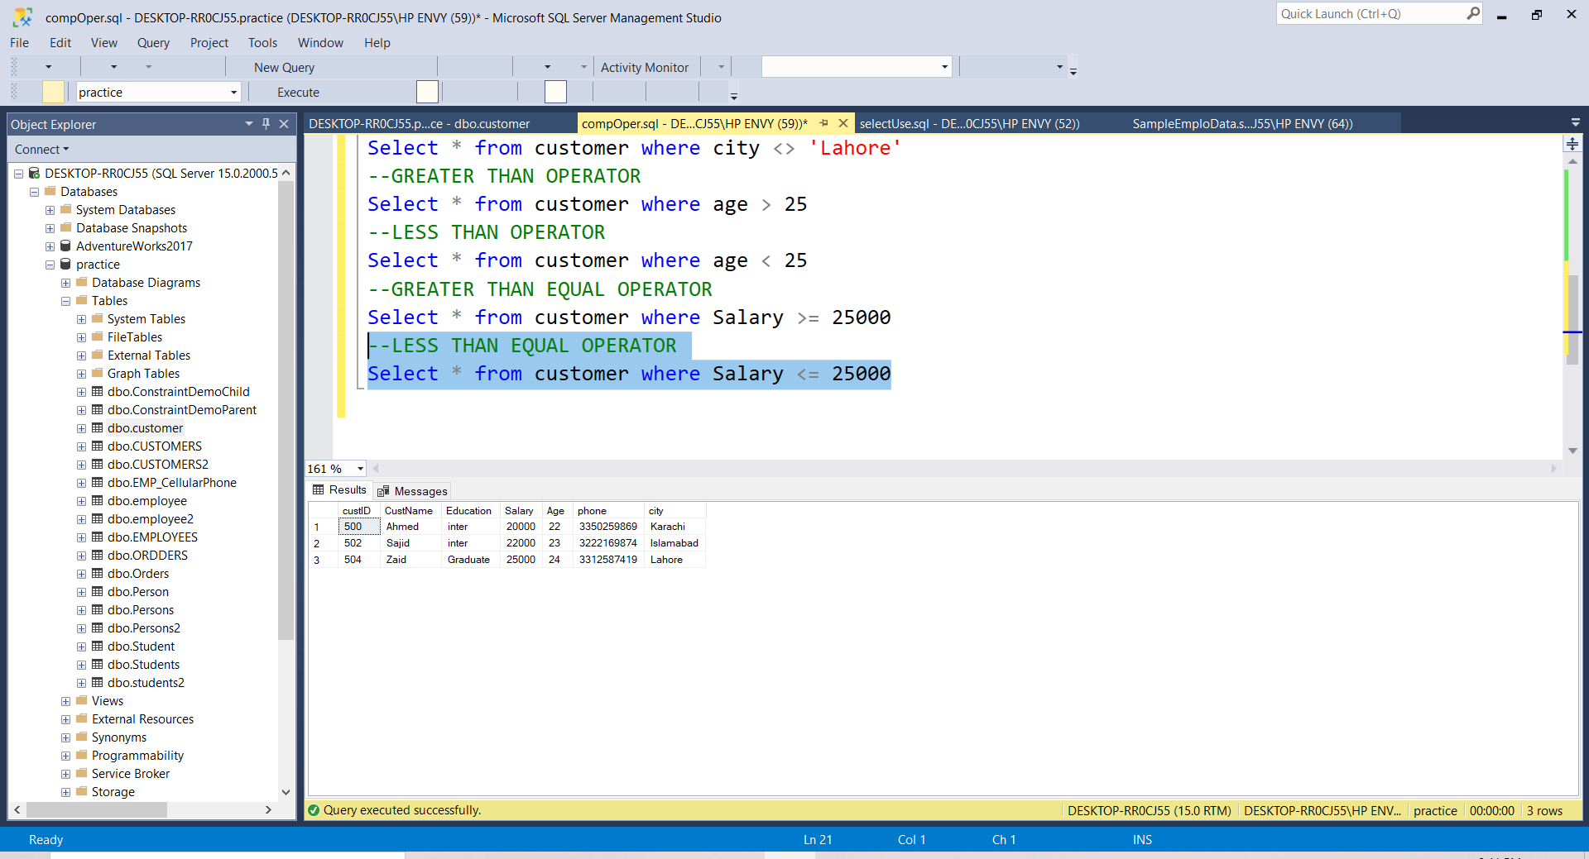
Less Than Equal Operator(>=)
The less than or equal to operator compares two non-null expressions and returns true if the left expression has a value less than or equal the value of the right expression; otherwise, it returns true.
For Example Customer Table
--LESS THAN EQUAL OPERATOR
Select * from customer where Salary <= 25000

Slide 54
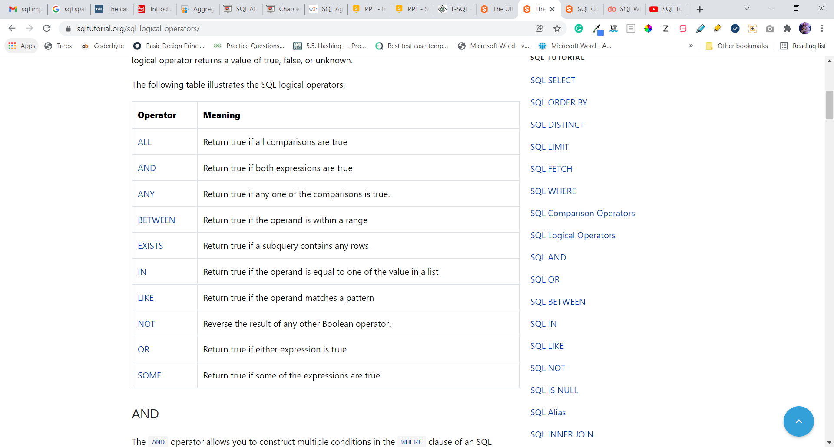
LOGICAL OPERATOR
A logical operator allows you to test for the truth of a condition. Similar to a comparison operator, a logical operator returns a value of true, false, or unknown.
The following table illustrates the SQL logical operators:

Slide 55
ALL LOGICAL OPERATOR
The ANY and ALL operators allow you to perform a comparison between a single column value and a range of other values.
The ALL operator:
returns a boolean value as a result
returns TRUE if ALL of the subquery values meet the condition
is used with SELECT, WHERE and HAVING statements
ALL means that the condition will be true only if the operation is true for all values in the range.
The ALL operator must be preceded by a comparison operator >, >=, <, <=, =, <> and followed by a subquery.
SYNTAX
SELECT column_name(s) FROM table_name WHERE column_name operator ALL (SELECT column_name FROM table_name WHERE condition);

Slide 56
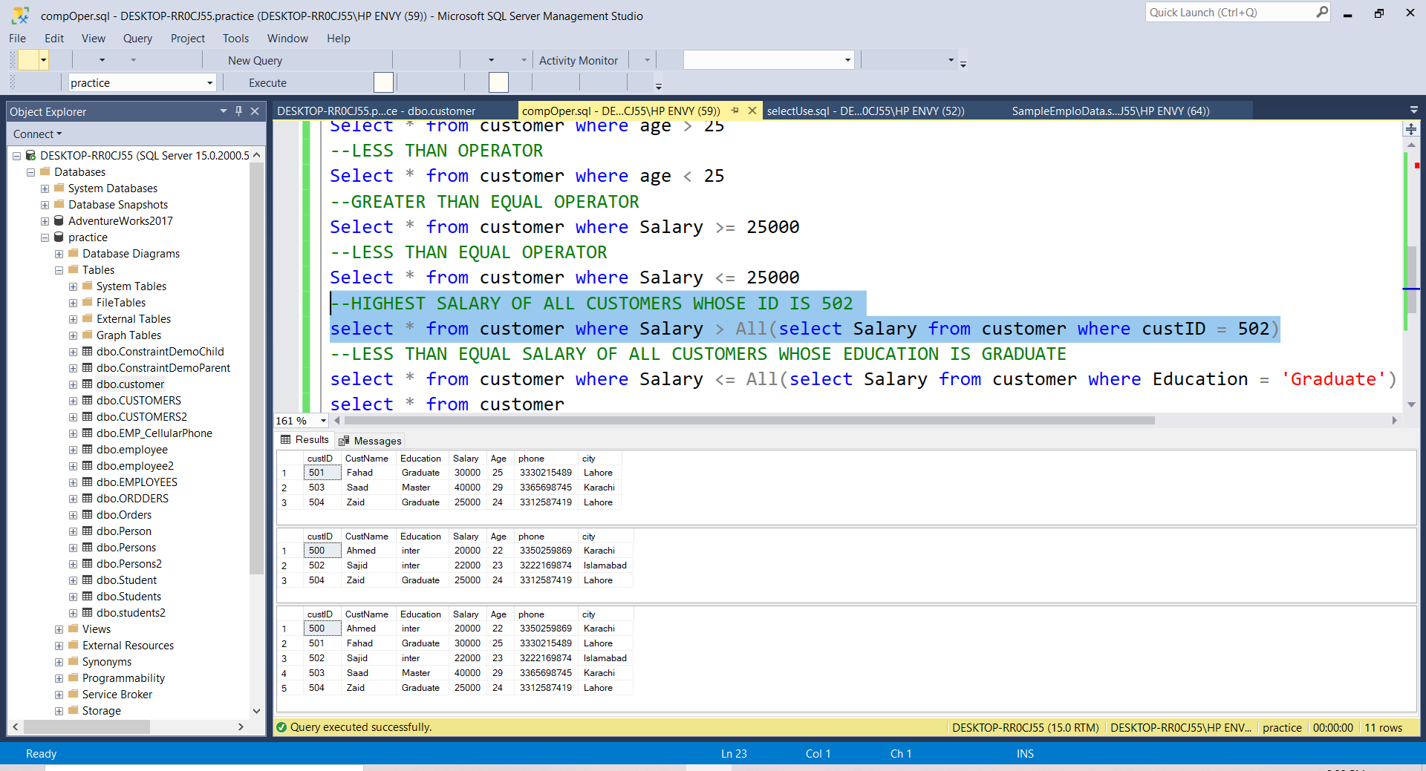
For Example Customer Table
finds all customers whose salaries are greater than the highest salary of employees in the Customer table whose id is 502:
--HIGHEST SALARY OF ALL CUSTOMERS WHOSE ID IS 502
select * from customer where Salary > All(select Salary from customer where custID = 502)

Slide 57

For Example Customer Table
Find less salaries of all customers whose education is graduate
--LESS THAN EQUAL SALARY OF ALL CUSTOMERS WHOSE EDUCATION IS GRADUATE
select * from customer where Salary < All(select Salary from customer where Education = 'Graduate')

Slide 58
ANY LOGICAL OPERATOR
The ANY and ALL operators allow you to perform a comparison between a single column value and a range of other values.
The ANY operator:
returns a boolean value as a result
returns TRUE if ANY of the subquery values meet the condition
ANY means that the condition will be true if the operation is true for any of the values in the range.
The ANY operator must be preceded by a comparison operator >, >=, <, <=, =, <> and followed by a subquery.
SYNTAX
SELECT column_name(s) FROM table_name WHERE column_name operator ANY (SELECT column_name FROM table_name WHERE condition);

Slide 59
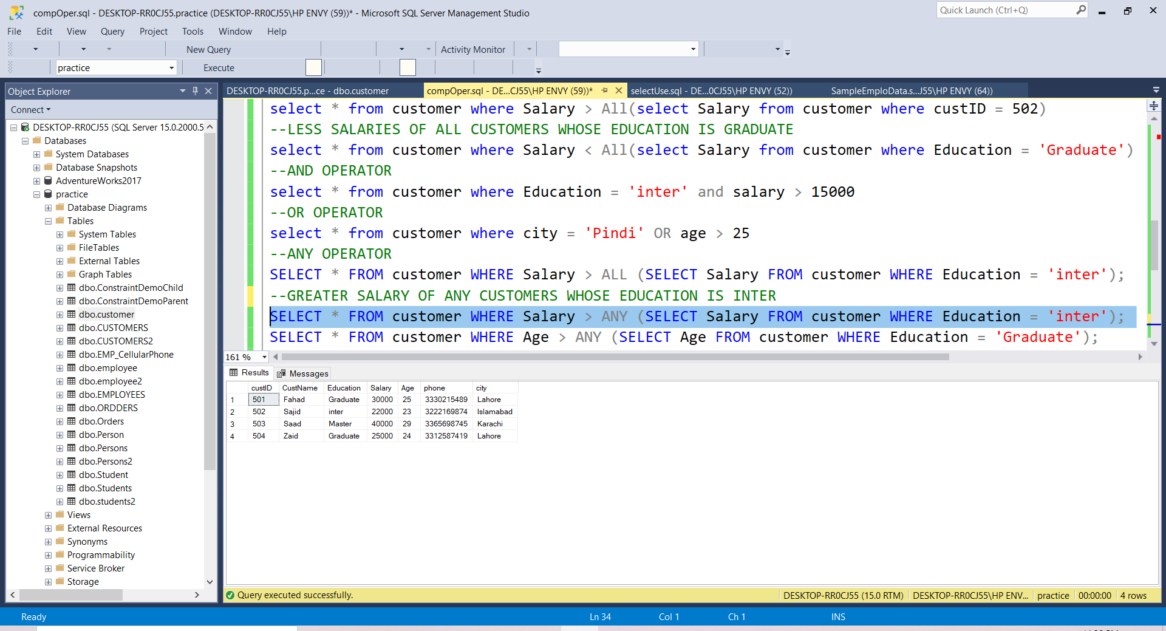
For Example Customer Table
Find greater salary of any customer whose education is inter
--GREATER SALARY OF ANY CUSTOMERS WHOSE EDUCATION IS INTER
SELECT * FROM customer WHERE Salary > ANY (SELECT Salary FROM customer WHERE Education = 'inter');

Slide 60
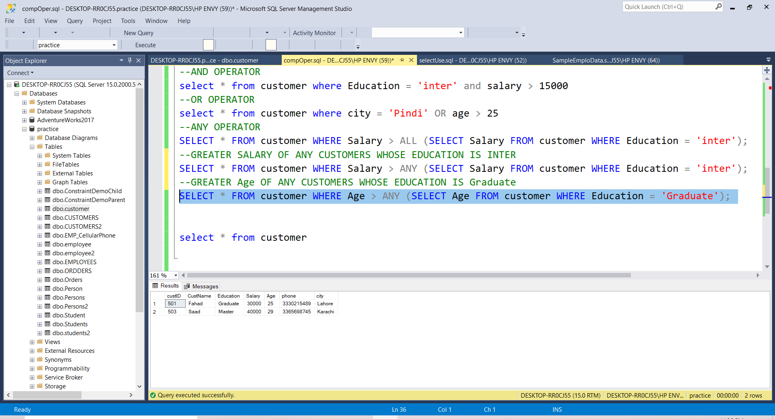
For Example Customer Table
Find greater age of any customer whose education is graduate
--GREATER Age OF ANY CUSTOMERS WHOSE EDUCATION IS Graduate
SELECT * FROM customer WHERE Age > ANY (SELECT Age FROM customer WHERE Education = 'Graduate');

Slide 61
AND OPERATOR
The AND operator returns true if both expressions evaluate to true. If one of the two expressions is false, then the AND operator returns false even one of the expressions is NULL.
The AND operator is typically used in the WHERE clause of the SELECT, UPDATE, or DELETE statement to form a flexible condition
SYNTAX
expression1 AND expression2;

Slide 62
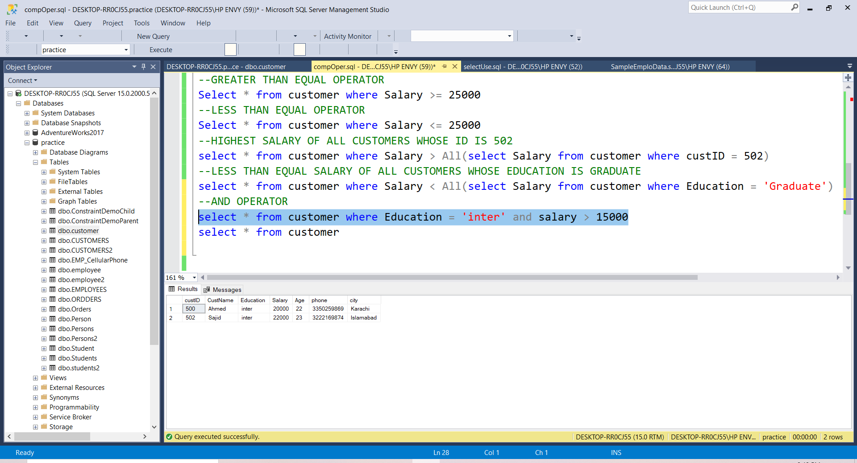
For Example Customer Table
To find all customers whose education is inter and salary greater than 15000
--AND OPERATOR
select * from customer where Education = 'inter' and salary > 15000

Slide 63
OR OPERATOR
The SQL OR is a logical operator that combines two boolean expressions. The SQL OR operator returns either true or false depending on the results of expressions.
The OR operator is typically used in the WHERE clause of the SELECT, UPDATE, or DELETE statement to form a flexible condition
SYNTAX
expression1 OR expression2;

Slide 64
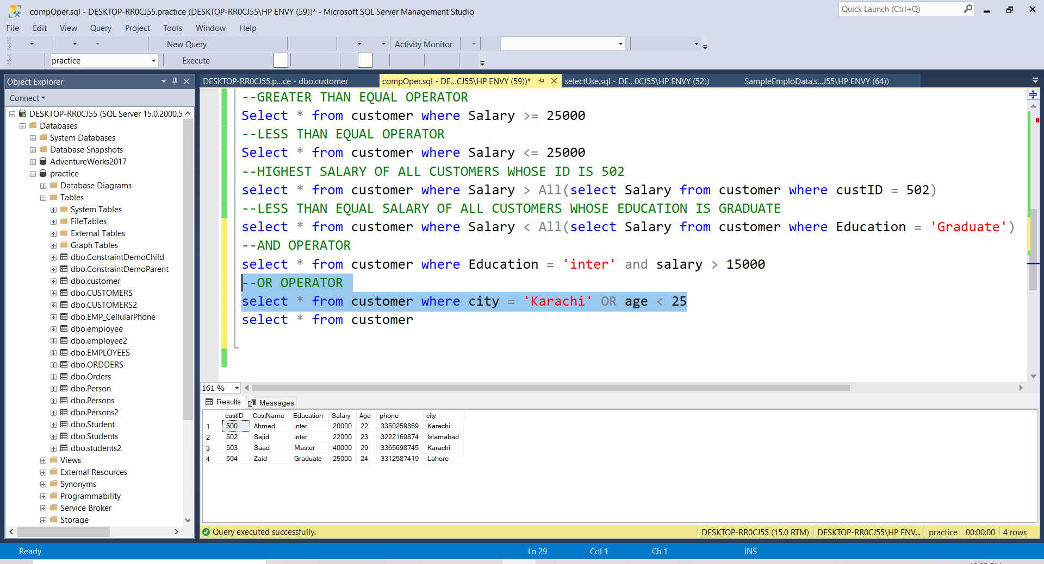
For Example Customer Table
To find all customers whose city is karachi Or age less than 25
--OR OPERATOR
select * from customer where city = 'Karachi' OR age < 25

Slide 65
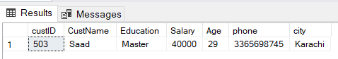
For Example Customer Table
To find all customers whose city is Pindi and age greater than 25
--OR OPERATOR
select * from customer where city = 'Pindi' OR age > 25

Slide 66
BETWEEN OPERATORS
The BETWEEN operator selects values within a given range. The values can be numbers, text, or dates.
The BETWEEN operator is inclusive: begin and end values are included.
SYNTAX
SELECT column_name(s) FROM table_name WHERE column_name BETWEEN value1 AND value2;

Slide 67
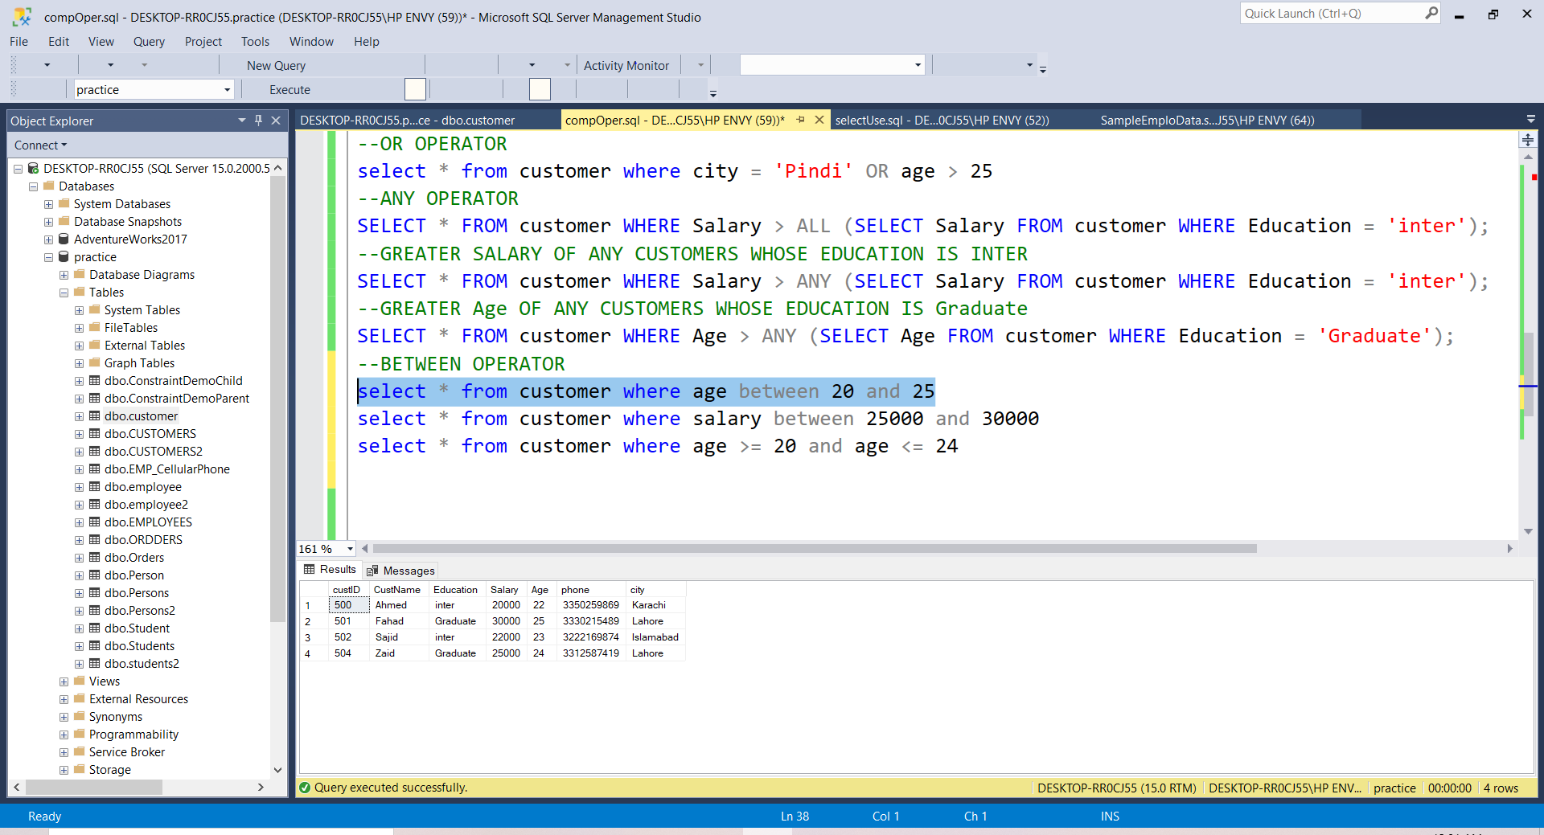
For Example Customer Table
To find all customers whose age between 20 to 25
--BETWEEN OPERATOR
select * from customer where age between 20 and 25

Slide 68
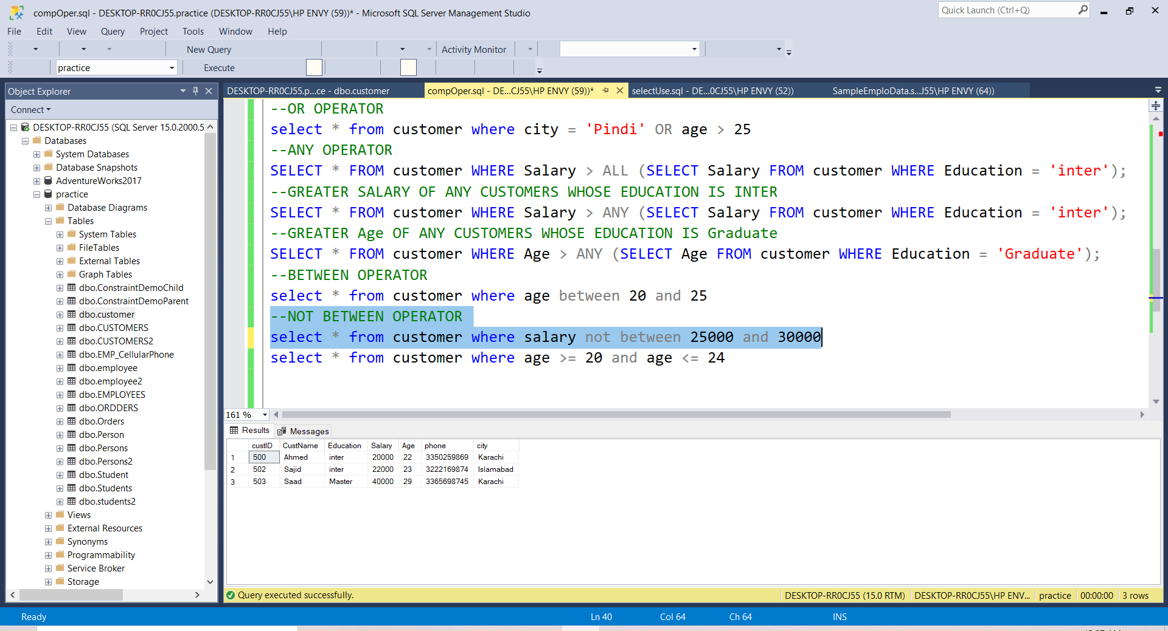
For Example Customer Table
To find all customers whose Salary not between 25000 to 30000
--NOT BETWEEN OPERATOR
select * from customer where salary not between 25000 and 30000

Slide 69
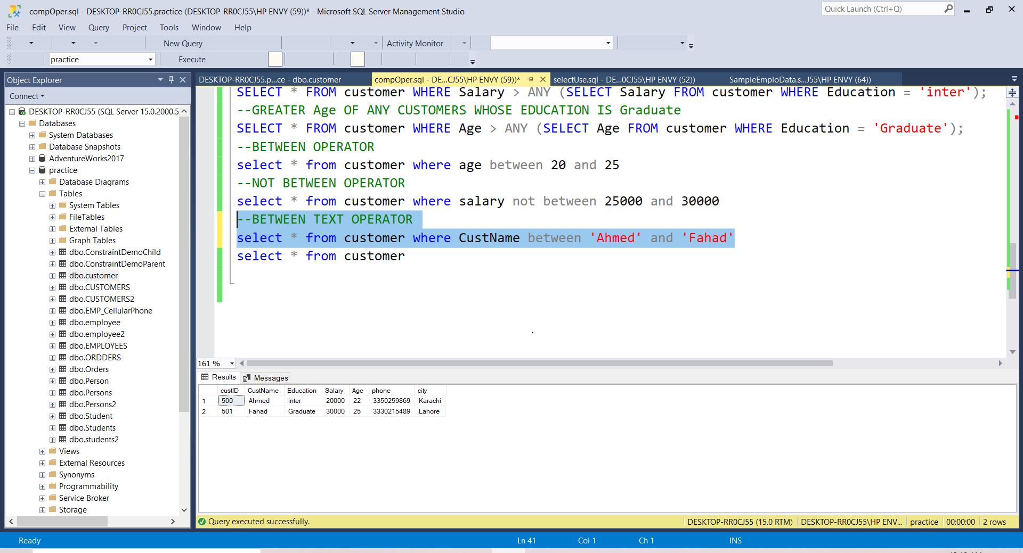
For Example Customer Table
To find all customers whose CustName between Ahmed to Fahad
--BETWEEN TEXT OPERATOR
select * from customer where CustName between 'Ahmed' and 'Fahad'

Slide 70
EXISTS Operator
The EXISTS operator is used to test for the existence of any record in a subquery.
The EXISTS operator returns TRUE if the subquery returns one or more records.
EXISTS Syntax
SELECT column_name(s) FROM table_name WHERE EXISTS (SELECT column_name FROM table_name WHERE condition);

Slide 71
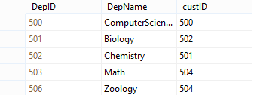
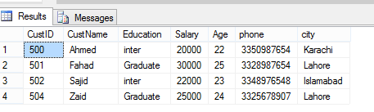
For Example Customer Table AND DEPARTMENT TABLE
Find the detail of customers who is exsist at least one department
--EXSIST OPERATOR
SELECT * FROM customer
WHERE EXISTS (SELECT custID FROM department WHERE department.custID = customer.custID);

Slide 72
IN Operator
The IN operator allows you to specify multiple values in a WHERE clause.
The IN operator is a shorthand for multiple OR conditions.
IN SYNTAX
SELECT column_name(s) FROM table_name WHERE column_name IN (value1, value2, ...);

Slide 73
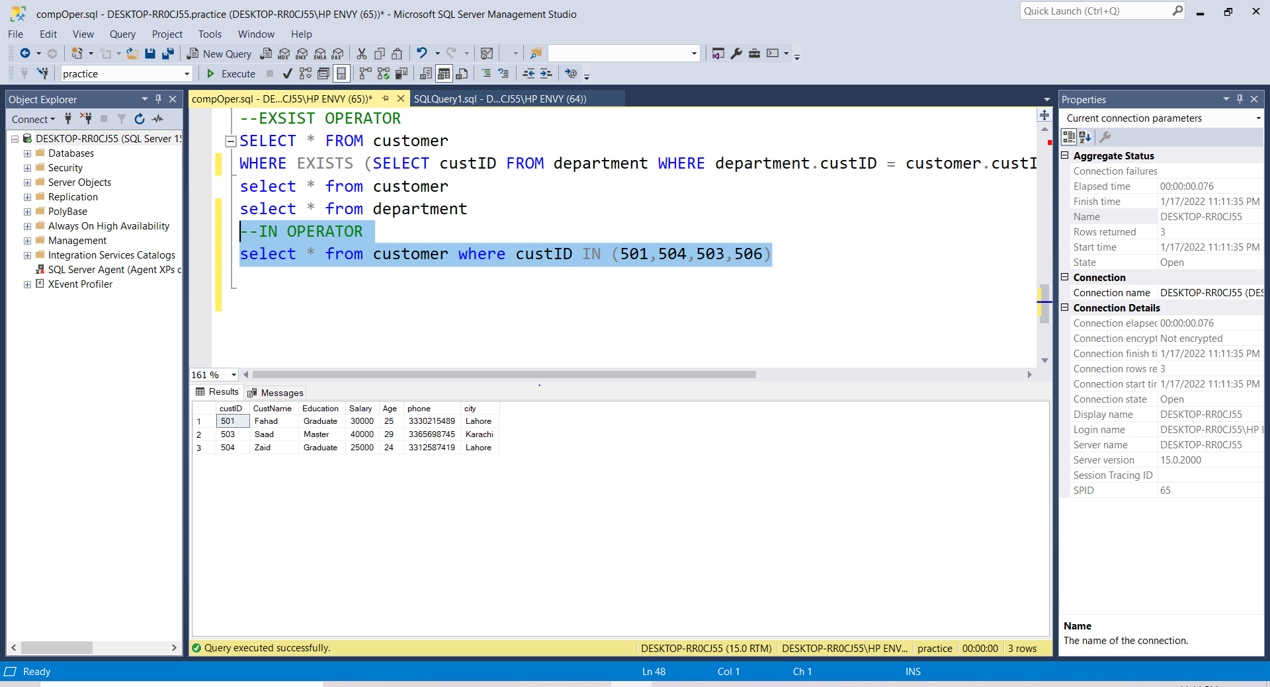
For Example Customer Table
Use the IN operator to find all customer with custID is 501,504,503,506
--IN OPERATOR
select * from customer where custID IN (501,504,503,506)

Slide 74
Like Operator
The LIKE operator is used in a WHERE clause to search for a specified pattern in a column.
There are two wildcards often used in conjunction with the LIKE operator:
The percent sign (%) represents zero, one, or multiple characters
The underscore sign (_) represents one, single character
LIKE SYNTAX
SELECT column1, column2, ... FROM table_name WHERE columnN LIKE pattern;

Slide 75
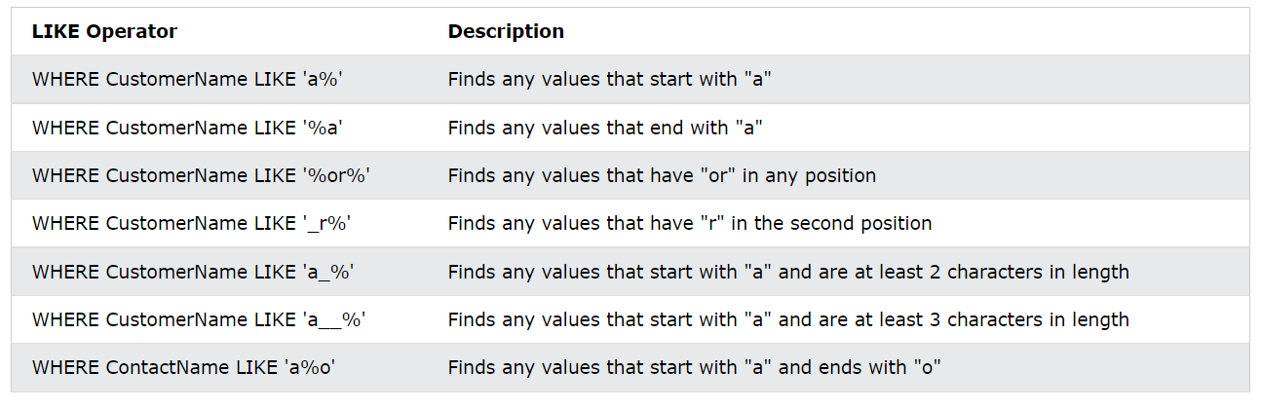
Cont.…
Here are some examples showing different LIKE operators with '%' and '_' wildcards:

Slide 76
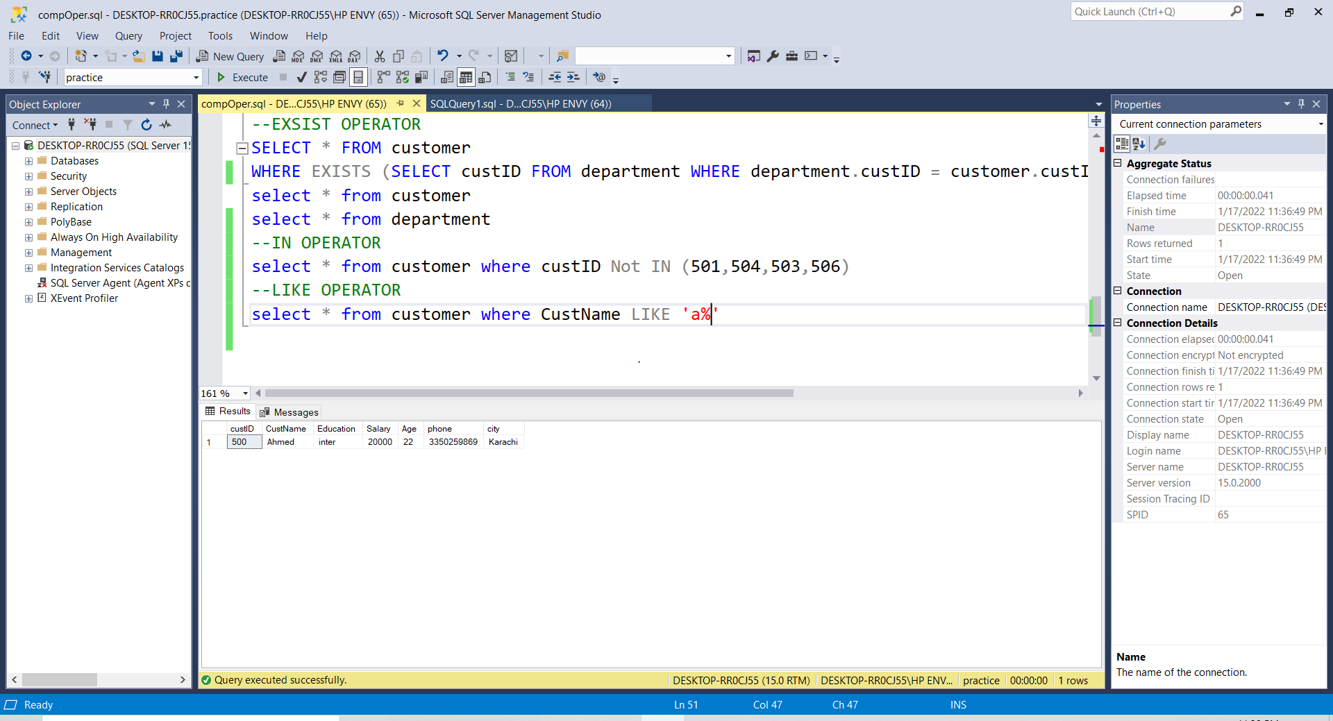
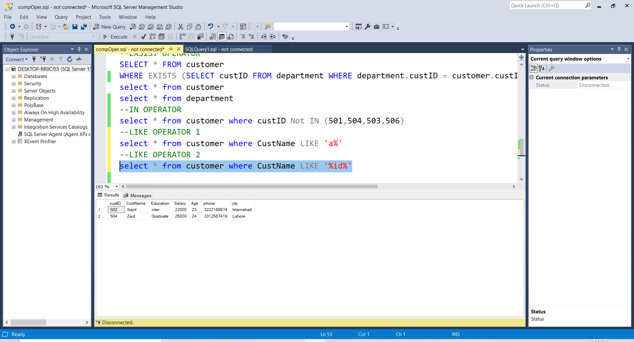
For Example Customer Table
Use the Like operator to find all customer with CustName start with ‘a’ and end with any values
Use the Like operator to find all customer with CustName start with any values that have ‘id’ in any position
--LIKE OPERATOR
select * from customer where CustName LIKE 'a%'
--LIKE OPERATOR 2
select * from customer where CustName LIKE '%id%'

Slide 77
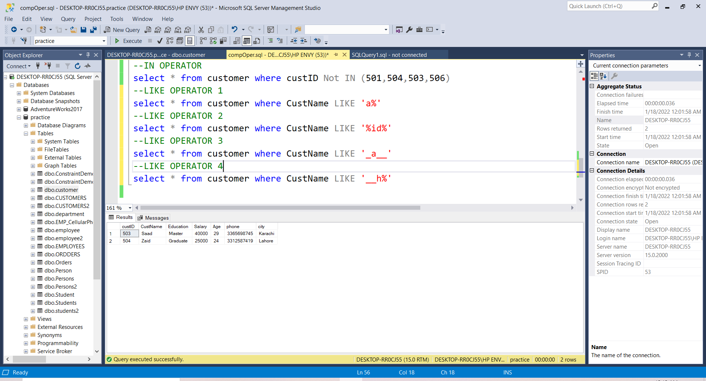
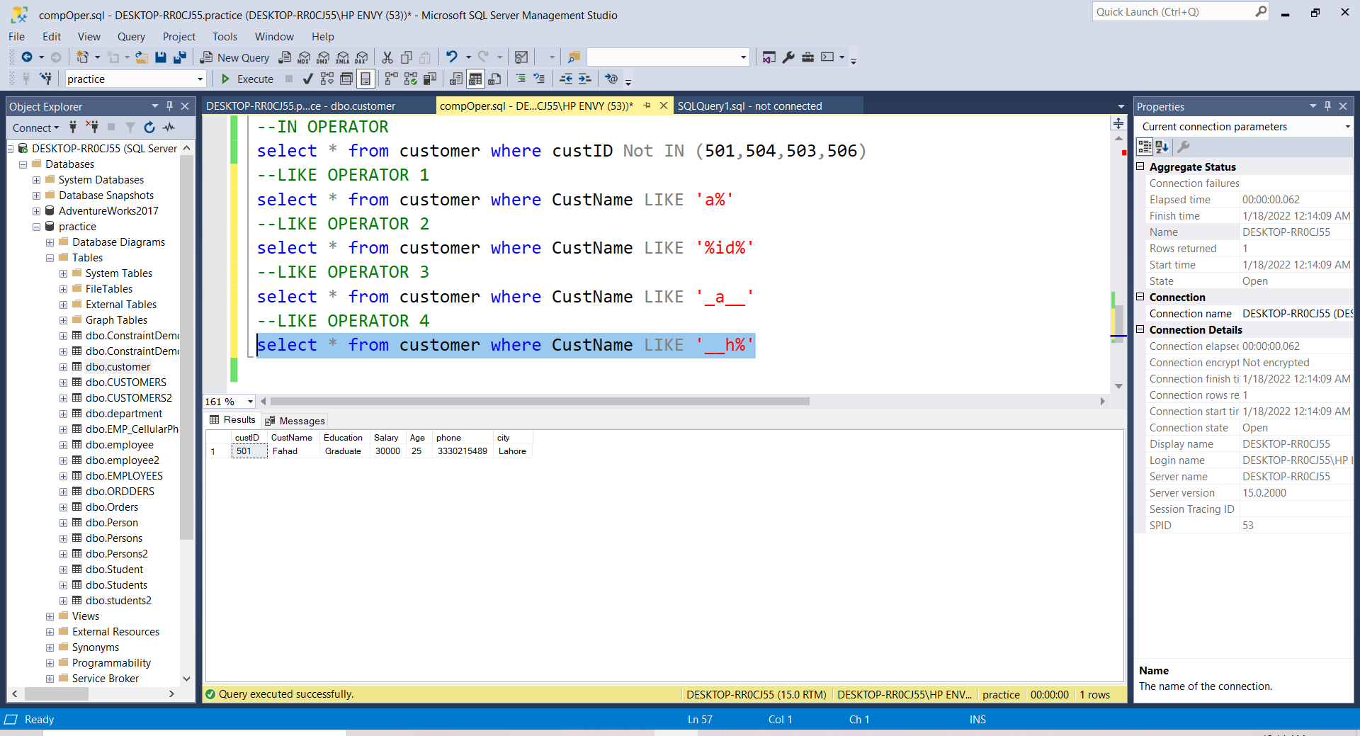
For Example Customer Table
Use the Like operator to find all customer with CustName start with any two character that have ‘h’ in third position and end with any number of values
Use the Like operator to find all customer with CustName start with any one character that have ‘a’ in second position and end with two characters
--LIKE OPERATOR 3
select * from customer where CustName LIKE '_a__'
--LIKE OPERATOR 4
select * from customer where CustName LIKE '__h%'

Slide 78
Not Operator
The NOT operator displays a record if the condition(s) is NOT TRUE.
NOT SYNTAX
SELECT column1, column2, ... FROM table_name WHERE NOT condition;

Slide 79
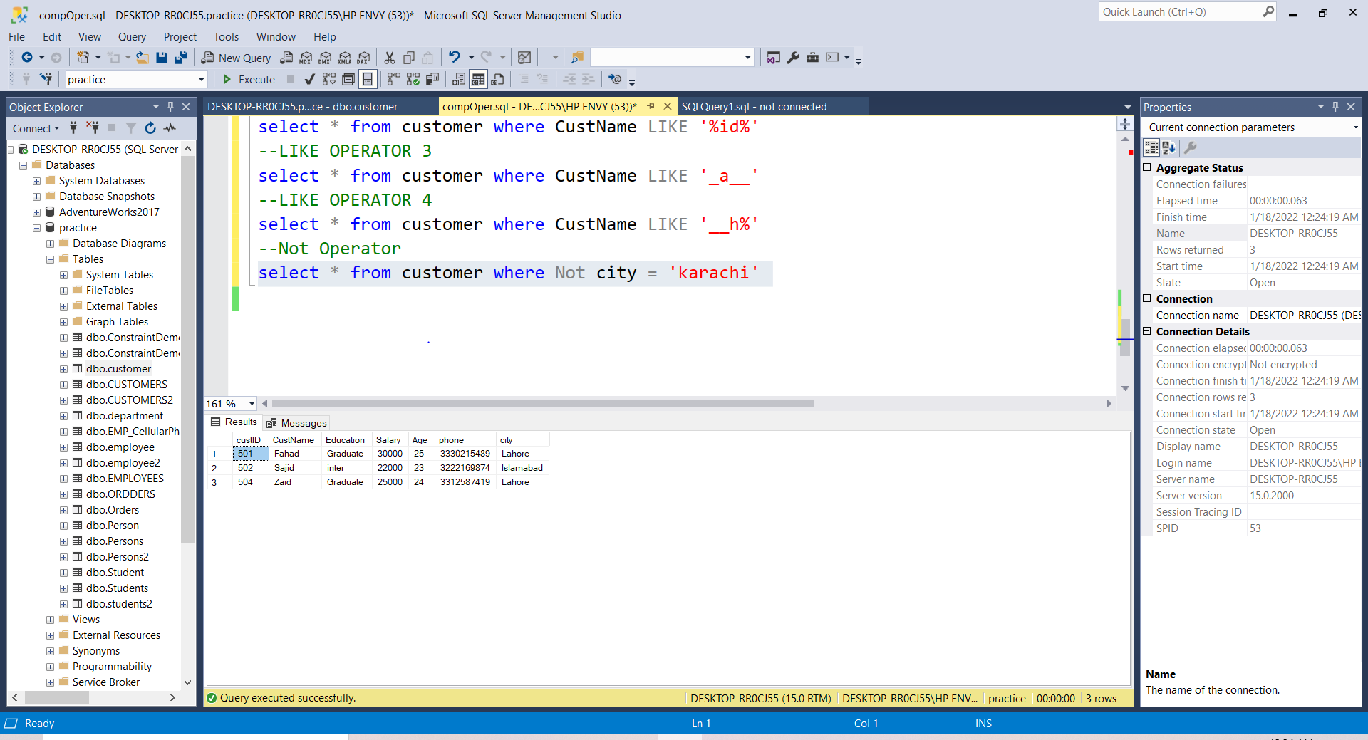
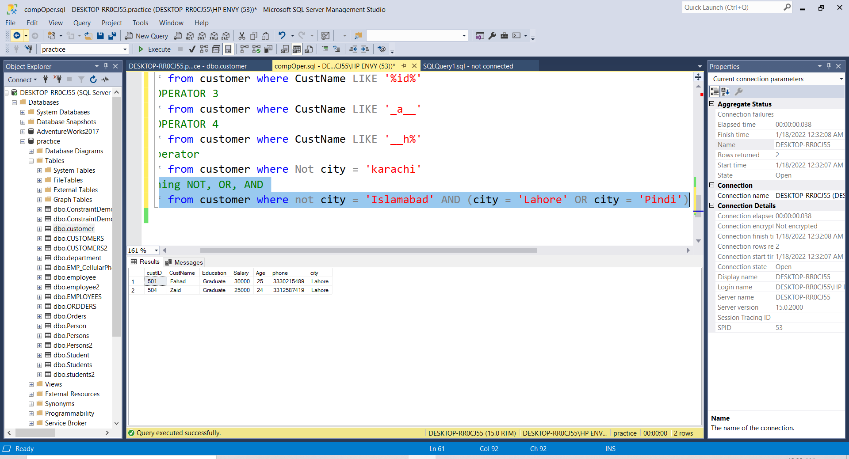
For Example Customer Table
Use the Not operator to find all customer with city is not Karachi
To find all customer where city is not Islamabad AND city must be Lahore OR Pindi
--Combining NOT, OR, AND
select * from customer where not city = 'Islamabad' AND (city = 'Lahore' OR city = 'Pindi')
--Not Operator
select * from customer where Not city = 'karachi'

Slide 80
ORDER BY CLAUSE

Slide 81
ORDER BY CLAUSE
The SQL ORDER BY is an optional clause of the SELECT statement.
The ORDER BY clause is used to sort the data in ascending or descending order, based on one or more columns.
Some databases sort the query results in an ascending order by default.
SYNTAX
SELECT column1, column2, ... FROM table_name ORDER BY column1, column2, ... ASC|DESC;

Slide 82
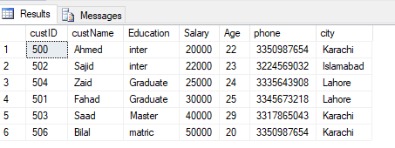
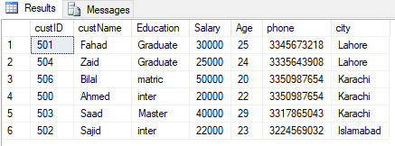
For Example Customer Table
To find all data from customer table, sorted by the Salary ASC
To find all data from customer table, sorted by the city DESC
--select all data from customer table, sorted by the Salary ASC
select * from customer order by Salary
--select all data from customer table, sorted by the city DSC
select * from customer order by city DESC

Slide 83
GROUP BY CLAUSE

Slide 84
GROUP BY CLAUSE
The GROUP BY statement groups rows that have the same values into summary rows, like "find the number of customers in each country".
The GROUP BY statement is often used with aggregate functions (COUNT(), MAX(), MIN(), SUM(), AVG()) to group the result-set by one or more columns.
These group by clause follows:
The SELECT statement is used with the GROUP BY clause in the SQL query.
Group by with where
Group by with null
Group by with all
Group by with having
Group by Syntax
SELECT column_name(s) function_name(column2) FROM table_name WHERE condition GROUP BY column_name(s) ORDER BY column_name(s);
Before Starting Group by Clause, We will see aggregate functions

Slide 85
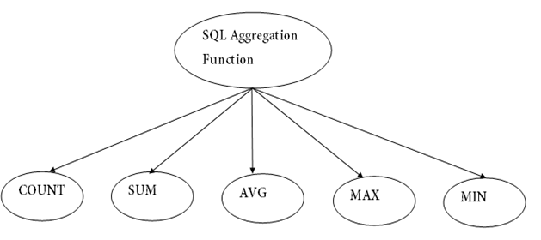
AGGREGATE FUNCTION
An aggregate function allows you to perform a calculation on a set of values to return a single scalar value. We often use aggregate functions with the GROUP BY and HAVING clauses of the SELECT statement.
It is also used to summarize the data.

Slide 86
AGGREGATE FUNCTION
The COUNT() function returns the number of rows that matches a specified criterion.
The SUM() function returns the total sum of a numeric column.
The AVG() function returns the average value of a numeric column.
The MIN() function returns the smallest value of the selected column.
The MAX() function returns the largest value of the selected column
Aggregate Function Syntax
SELECT functionName(column_name) FROM table_name WHERE condition;

Slide 87
EXAMPLE OF AGGREGATE FUNCTIONS

Slide 88
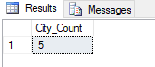
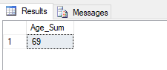
For Example Customer Table
To count city from customer table
To Sum Age from customer table where age less than 25
--To Sum Age from customer table where age less than 25
select sum(age) as Age_Sum from customer where age < 25
--To count city from customer table
select COUNT(city) as City_Count from customer

Slide 89
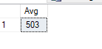
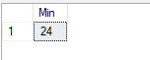
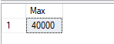
For Example Customer Table
To Avg CustomerID from customer table where CustomerID greater than equal 502
To find min Age from customer table where Education equal to graduate
To find max salary from customer table where city equal to Karachi
--To Avg CustomerID from customer table where CustomerID greater than equal 502
select avg(custID) as Avg from customer where custID >= 502
--To find min Age from customer table where Education equal to graduate
select min(age) as Min from customer where Education = 'Graduate’
--To find max salary from customer table where city equal to Karachi
select max(salary) as Max from customer where city = 'Karachi'

Slide 90
Now Start Example of Group By Clause

Slide 91
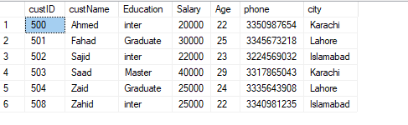
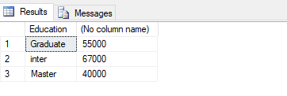
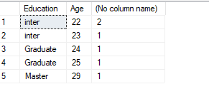
For Example Customer Table
To find the sum of salary for each customer education by using the group by clause and sum function
To find the count of city for each education and Age by using the group by clause and sum function
--GROUP BY SINGLE COLUMN
select Education,sum(Salary) from customer group by Education
--GROUP BY MULTIPLE COLUMN
select Education,Age,count(city) from customer group by Education,Age

Slide 92
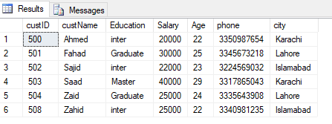
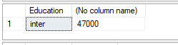
GROUP BY WHERE
The where clause can be used with group by clause to restrict the row for grouping.
The rows that satisfy the search condition are considered for grouping
For Example
To find the sum of salary in customers table according to group by education where education groups according to city name start with “I” and end with any values
--GROUP BY WITH WHERE
select Education,sum(salary) from customer
where city like 'I%' group by Education

Slide 93
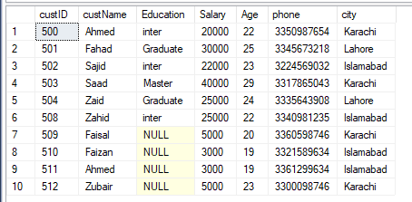
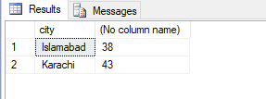
GROUP BY NULL
If the grouping column contain a null value, that row become a separate group in the result set.
For Example
To find the sum of age in customers table according to group by city where city groups according to Education are Null
--GROUP BY NULL
select city, sum(age) from customer
where Education is null group by city

Slide 94
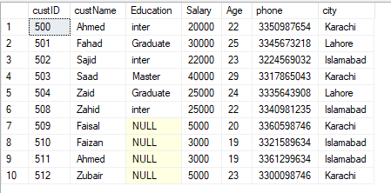
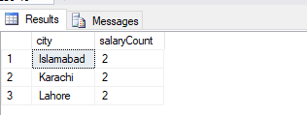
GROUP BY WITH ALL
ALL is significant only when the SELECT has a WHERE clause.
When ALL is used. It includes all the group by clause produces.
It even includes those groups which do not meet the search conditions.
For Example
To find the count of salary in customer table according to the group by city where city group according to
Customer Name like pattern where like start with F and end with any values or like start with Z or end with any values
--GROUP BY WITH ALL
select city, count(salary) as salaryCount from customer where custName like 'F%' OR custName like 'Z%' group by All city

Slide 95
SUMMARIZING DATA
Group by clause also uses operator like
Cube
Rollup
CUBE generates a result set that shows aggregates for all combinations of values in the selected columns.
ROLLUP generates a result set that shows aggregates for a hierarchy of values in the selected columns.

Slide 96
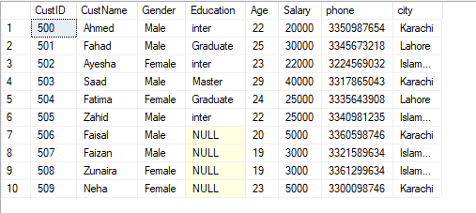

ROLLUP AND CUBE EXAMPLE
Write a query to retrieve the total salary in all cities, you add the ROLLUP to the GROUP BY clause.
Write a query to retrieve the total salary in all cities, you add the CUBE to the GROUP BY clause.
-- WITH ROLLUP AND CUBE SINGLE COLUMN
select COALESCE(city, 'City_GrandTotal') as City, sum(Salary) as City_Wise_Salary_Sum
from customer2 group by city with rollup/with cube

Slide 97

ROLLUP EXAMPLE
Write a query to retrieve the total salary in all cities according to gender and as well as grandTotal, you add the ROLLUP to the GROUP BY clause.
Total salary in Islamabad
Total salary in Karachi
---- WITH ROLLUP MULTIPLE COLUMN
select city, gender, sum(salary) as Salary_Sum
from customer2 group by city, gender with rollup
Total salary in Lahore
Grand Total salary in all city

Slide 98

CUBE EXAMPLE
Write a query to retrieve the total salary in all cities, you add the ROLLUP to the GROUP BY clause.
Total salary all cities according to females
---- WITH Cube MULTIPLE COLUMN
select city, gender, sum(salary) as Salary_Sum
from customer2 group by city, gender with cube
Total salary all cities according to Males
Total salary all cities and gender according

Slide 99
HAVING CLAUSE

Slide 100
HAVING CLAUSE
Having clause is used to filter data based on the group functions.
The difference between the having and where clause in sql is that the where clause can not be used with aggregates, but the having clause can.

Slide 101

HAVING CLAUSE EXAMPLE
To find the sum of salary in customers table according to group by city whose salary is greater than 35000
select education, sum(salary) from customer2
group by education having sum(salary) > 45000

Slide 102

To find the count of salary in customer table according to the group by city and gender where gender group only female and whose salaries in each cities is less than equal to 30000. sorted by the city DESC
select gender,city,sum(salary) as Total from customer2
where gender = 'Female' group by city,Gender
having sum(salary) <= 30000 order by city desc

Slide 103
CLAUSES AND STATEMENT

Slide 104
Common Table Expression (CTE) in SELECT and INSERT statement
Microsoft SQL Server provides enhanced query syntax elements for more powerful data accessing and processing.
A CTE is a named temporary result set based on the regular SELECT and INSERT query.

Slide 105
SUBQUERIES

Slide 106
A Subquery is also called an inner query or inner select, while the statement containing a subquery is also called an outer query or outer select
Rules:
Sub queries must be enclosed within paretheses
You can use the comparission operators such as >,< or = IN,ANY or ALL
An order by command cannot be used in a sub query

Slide 107

NOTE:
The inner query executes first before its parent query so that the results of an inner query can be passed to the outer query.

Slide 108

TYPES OF SUBQUERIES

Slide 109



SUBQUERY IN SINGLE ROW
Sub query must return single row value. A equal (=) operator is use for single row return.
EXAMPLE
How to find the marks of students whose name is ‘Fatima’ and live in ‘Lahore’
--SUBQUERRY IN SINGLE ROW
select * from Student_Marks where StdID = (select stdID from student_Info where Std_Name = 'Fatima' AND city = 'Lahore')

Slide 110

Sub QUERIES MULTIPLE RECORDS
A IN operator is used for multiple row return
How to find the marks of students who lived in Islamabad
--SUBQUERRY IN MULTIPLE ROW
select * from Student_Marks where StdID IN (select StdID from student_Info where city = 'Islamabad')

Slide 111
SET OPERATOR

Slide 112
SET OPERATORS
The SET Operators in SQL Server are mainly used to combine the result of more than 1 select statement and return a single result set to the user. There are the following 4 set operators available in SQL Server.
They are as follows:
UNION: Combine two or more result sets into a single set, without duplicates.
UNION ALL: Combine two or more result sets into a single set, including all duplicates.
INTERSECT: Takes the data from both result sets which are in common.
EXCEPT: Takes the data from the first result set, but not in the second result set (i.e. no matching to each other)

Slide 113
EXAMPLE OF SET OPERATOR

Slide 114
Suppose we have a very simple database that stores information about books and movies. It has only two tables, BOOKS and MOVIES, which contain book and movie titles (respectively) and an ID number. As you look at these tables, notice that one title appears in both:

Slide 115
PIVOT AND UNPIVOT OPERATOR

Slide 116
The PIVOT feature or concept in SQL databases allows you to change the data from being displayed in rows to columns.
It groups your data based on some values and shows these in columns instead.
If you’ve ever created a Pivot Table in Excel and want to have a pivot table in SQL, then the Pivot feature is how you do it.

Slide 117
SQL JOINS

Slide 118
SQL JOINS
A JOIN clause is used to combine rows from two or more tables, based on a related column between them.
ANSI standard SQL defines five types of JOIN
inner join,
left outer join,
right outer join,
full outer join, and
cross join

Slide 119

INNER JOIN
The INNER JOIN is formed when records from two tables are combined only if the rows from both the tables are matched based on a common column.
It represents the default join-type.
SELECT column_name(s) FROM table1 INNER JOIN table2 ON table1.column_name = table2.column_name;

Slide 120
Example Of INNER JOIN

Slide 121



Write a query to display all the details from employee aand Department where the value of EmpID in Employee is equal to the value of Emp_ID in department table
select *from Employee Emp INNER JOIN department dep ON Emp.EmpID = dep.Emp_ID

Slide 122
OUTER JOIN
In the SQL outer JOIN all the content of the both tables are integrated together either they are matched or not.
Left Outer Join
Right Outer Join

Slide 123

LEFT OUTER JOIN
The LEFT JOIN keyword returns all rows from the left table (table_name1), even if there are no matches in the right table (table_name2).
SELECT column_name(s) FROM table1 LEFT JOIN table2 ON table1.column_name = table2.column_name;

Slide 124
Example Of Left Outer Join

Slide 125

Write a query to display all the details from employee and common details from Department by using left join keyword
select *from Employee Emp LEFT JOIN department dep ON Emp.EmpID = dep.Emp_ID

Slide 126

Right OUTER JOIN
The RIGHT JOIN keyword returns all the rows from the right table (table_name2), even if there are no matches in the left table (table_name1).
SELECT column_name(s) FROM table1 RIGHT JOIN table2 ON table1.column_name = table2.column_name;

Slide 127
Example Of Right Outer Join

Slide 128
Write a query to display common details from employee and all the details from Department by using right join keyword
select *from Employee Emp LEFT JOIN department dep ON Emp.EmpID = dep.Emp_ID

Slide 129

FULL OUTER JOIN
The FULL JOIN keyword return rows when there is a match in one of the tables.
SELECT column_name(s) FROM table1 Full JOIN table2 ON table1.column_name = table2.column_name;

Slide 130
SQL VIEW

Slide 131
SQL VIEWS
A view is a virtual table that is made up of selected columns from one or more tables.
The tables from which the view is created are referred to as base tables.
These base tables can be from different databases.
A view can also include columns from other views created in the same or a different database.
A view can have a maximum of 1024 columns.
The data inside the view comes from the base tables that are referenced in the view definition.
The rows and columns of views are created dynamically when the view is referenced.

Slide 132

SQL VIEW UNDERSTAND USING DIAGRAM

Slide 133
ADVANTAGES USING VIEWS
Simplify Queries
The main advantage to using views is that they simplify your queries.
As we learned above, views are just stored SQL statements. These statements can include, for example:
Selecting of different columns
Joins to other tables
Functions, including aggregate functions
WHERE clauses
GROUP BY and HAVING
So, if you have a complicated query or logic that’s used in many places, you can use a view to hold that logic. You can then query from that view whenever you need that data.
For example you can create a view that counts the number of orders and totals the order volume for all orders for each month. You can then query this view and limit by month to find the data you need for a specific month.

Slide 134
ADVANTAGES USING VIEWS
Security
Another benefit of using views is increased security. You can create a view that only selects certain columns from a table. Then, certain users, or applications, can be given access to this view rather than the entire table.
For example, you may have an employee table with salary information. You might not want all applications or users to see this salary information.
So, you can create a view that selects all columns except for the salary columns, and then give access to that view to other users (and don’t give them access to the employee table).

Slide 135

This means when they query the employee view, they won’t see the salary information.

Slide 136
CREATE VIEW
A view is created using the CREATE VIEW statement and it can be created only in the current database.
SQL Server verifies the existence of objects that are referenced in the view definition.
The syntax used to create a view is as follows:
CREATE VIEW view_name AS SELECT column1, column2, ... FROM table_name WHERE condition;

Slide 137
EXAMPLE OF SQL VIEWS

Slide 138


Create a View for Security
FOR EXAMPLE
create a view on the employee table that shows all employee data except for the salary column. This way, only certain users can access the full table, and everyone else can access the view.
create view vwEmployee as select EmpID,EmpName,Gender,phone,city,Email,Hiredate from Employee
select * from vwEmployee
Employee Table
View Employee Table

Slide 139

View With Joins
create a view that shows all employee and department information in the one view.
create view vwEmpDep as select
e.EmpID,e.EmpName,e.Gender,e.phone,e.city,e.Email,e.Hiredate,
d.depid,d.Department
from Employee e Inner Join Department d on e.EmpID = d.Emp_ID
select * from vwEmpDep
Employee Table
View JOIN Employee AND DEPARTMEN Table

Slide 140
GUIDELINES AND RESTRICTION ON VIEW
A view can be created using the CREATE VIEW command.
View names must be unique and cannot be the same as the table names in the schema.
A view cannot be created on temporary tables.
A view cannot have a full-text index.
A view cannot contain the DEFAULT definition.
The CREATE VIEW statement can include the ORDER BY clause only if the TOP keyword is used.
Views cannot reference more than 1024 columns.
The CREATE VIEW statement cannot include the INTO keyword. The CREATE VIEW statement cannot be combined with other Transact-SQL statements in a single batch.

Slide 141
INSERT WITH VIEWS
The INSERT statement is used to add a new row to a table or a view. The value of column is automatically provided if:
The column has an IDENTITY property.
The column has a default value specified.
The column has a timestamp data type.
The column takes null values.
The column is a computed column.
While using the INSERT statement on a view, if any rules are violated, the record is not inserted.

Slide 142

INSERT WITH VIEWS
FOR EXAMPLE
INSERT Employee View Table
Employee View Table
insert into vwEmployee (EmpID,EmpName,Gender,city) values (202,'Fatima','Female','Karachi')

Slide 143
NO INSERT WITH VIEWS
Some rules and guidelines must be followed when using the INSERT statement otherwise when data is inserted through the view, the insertion does not take place as the view.
The INSERT statement must specify values for all columns in a view in the underlying table that do not allow null values and have no DEFAULT definitions.
When there is a self-join with the same view or base table, the INSERT statement does not work
Values can be inserted into user-defined data type columns by
Specifying a value of the user-defined type.
Calling a user-defined function that returns a value of the user-defined type.

Slide 144


No INSERT WITH VIEWS
FOR EXAMPLE
create table Product(productId int not null identity(500,1),
productName varchar(225) not null,Category varchar(225),
CustName varchar(225));
select * from Product
CREATE VIEW
create view vwProduct as select * from product
select * from vwProduct
Insert into vwProduct (productId,productName, CustName,Category)values(506,'Carrot','Sajid' ,'Vegetables')
INSERT VIEW
ERROR MSG

Slide 145


UPDATE AND DELETE WITH VIEWS
update vwEmployee set Email = 'fatima20@gmail.com' where EmpID = 202
delete from vwEmployee where phone is null

Slide 146
ALTERING VIEWS
Besides modifying the data within a view, users can also modify the definition of a view.
The ALTER VIEW statement modifies an existing view without having to reorganize its permissions and other properties.
Views are often altered when a user requests for additional information or makes changes in the underlying table definition.
SYNTAX
ALTER VIEW AS <select_statement>

Slide 147
DROP VIEWS
A view can be removed from the database using the DROP VIEW statement.
When a view is dropped, the data in the base tables remains unaffected.
The definition of the view and other information associated with the view is deleted from the system catalog.
All permissions for the view are also deleted.
The syntax used to drop a view is as follows:
DROP VIEW <view_name>

Slide 148
DEFINITION OF VIEWS
The definition of a view helps to understand how its data is derived from the source tables.
The sp_helptext stored procedure displays view related information when the name of the view is given as its parameter.
The syntax used to view the definition information of a view is as follows:
sp_helptext <view_name>

Slide 149
SP_refreshview
The sp_refreshview stored procedure updates the metadata for the view.
If the sp_refreshview procedure is not executed, the metadata of the view is not updated to reflect the changes in the base tables.
This results in the generation of unexpected results when the view is queried.
The sp_refreshview stored procedure returns code value zero if the execution is successful or returns a non-zero number in case the execution has failed.
The syntax used to run the sp_refreshview stored procedure is as follows:
Syntax: sp_refreshview

Slide 150
STORED PROCEDURE

Slide 151
WHAT IS SQL STORED PROCEDURE
A stored procedure is a set of SQL statements that can be executed on the database. It is stored as an object in the database.
A stored procedure allows for code that is run many times to be saved on the database and run at a later time, making it easier for yourself and other developers in the future.
It also allows for extra features that aren’t available in regular SQL language to be used, such as loops, output, and manipulation variables.

Slide 152
ADVANTAGES OF SQL STORED PROCEDURE
The advantages of using stored procedures are as follows:
Improved Security
Precompiled Execution
Reduced Client/Server Traffic
Reuse of Code

Slide 153
TYPES STORED PROCEDURE

Slide 154
TYPES OF STORED PROCEDURE
SQL Server supports the following types of stored procedures
User-Defined Stored Procedures
Extended Stored Procedures
System Stored Procedures
Temporary Stored Procedure

Slide 155
USER DEFINED STORED PROCEDURE
User-defined stored procedures are also known as custom stored procedures.
These procedures are used for reusing Transact-SQL statements for performing repetitive tasks.
There are two types of user-defined stored procedures, the Transact-SQL stored procedures and the Common Language Runtime (CLR) stored procedures.
Transact-SQL stored procedures consist of Transact-SQL statements whereas the CLR stored procedures are based on the .NET framework CLR methods.
Both the stored procedures can take and return user-defined parameters.

Slide 156
REMOTE STORED PROCEDURE
Stored procedures that run on remote SQL Servers are known as remote stored procedures.
When a remote stored procedure is executed from a local instance of SQL Server to a client computer, a statement abort error might be encountered

Slide 157
EXTEND STORED PROCEDURE
Extended stored procedures help SQL Server in interacting with the operating system.
Extended stored procedures are not resident objects of SQL Server.
They are procedures that are implemented as dynamic-link libraries (DLL) executed outside the SQL Server environment.
Syntax:
EXECUTE <procedure_name>
Following code snippet executes the extended stored procedure xp_fileexist to check whether the MyTest.txt file exists or not.
EXECUTE xp_fileexist 'c:\MyTest.txt

Slide 158

TEMPORARY STORED PROCEDURE
Stored procedures created for temporary use within a session are called temporary stored procedures.
These procedures are stored in the tempdb database.
The tempdb system database is a global resource available to all users connected to an instance of SQL Server.
SQL Server supports two types of temporary stored procedures namely, local and global.
The table lists the differences between the two types of stored procedures.

Slide 159
SYSTEM STORED PROCEDURE
These stored procedures are already defined in SQL Server.
These are physically stored in hidden SQL Server Resource Database and logically appear in the sys schema of each user-defined and system-defined database.
This procedure starts with the sp_ prefix.
Hence we don't use this prefix when naming user-defined procedures.

Slide 160
SYSTEM STORED PROCEDURE
Here is a list of some useful system defined procedure.
sp_help | It provides details on any database object
Sp_tables | Returns a list of objects like tables or views.
sp_helptext | It provides the text of a stored procedure reside in SQL Server
Sp_who | Returns information about current users, sessions, and processes in an instance of the SQL Server.
Sp_stored_procedure | Returns a list of stored procedures.
Sp_rename | Changes the name of a object in the current database.
sp_changedbowner | used to change the owner of the current database.

Slide 161
In SQL Server, users are allowed to create customized or user-defined stored procedures for performance of various tasks.
The syntax used to create a custom stored procedure is as follows:
CREATE { PROC | PROCEDURE } procedure_name [ { @parameter data_type } ]
AS <sql_statement>
where,
procedure_name: specifies the name of the procedure.
@parameter: specifies the input/output parameters in the procedure.
data_type: specifies the data types of the parameters.
sql_statement: specifies one or more Transact-SQL statements to be included in the procedure.

Slide 162

CREATE STORED PROCEDURE
create procedure spCustomer
AS
BEGIN
select * from customer where gender = 'male'
select Education,sum(salary) as Sum_Salary_Karachi from customer
where city = 'Karachi' group by Education
END

Slide 163
USING PARAMETERS
The real advantage of a stored procedure comes into picture only when one or more parameters are used with it.
This data transfer is done using parameters. Parameters are of two types that are as follows:
Input parameters allow the calling program to pass values to a stored procedure.
These values are accepted into variables defined in the stored procedure.
INPUT PARAMETER
Output parameters allow a stored procedure to pass values back to the calling program
These values are accepted into variables by the calling program
OUTPUT PARAMETER

Slide 164
INPUT STORED PROCEDURE
Values are passed from the calling program to the stored procedure and these values are accepted into the input parameters of the stored procedure.
The input parameters are defined at the time of creation of the stored procedure.
The values passed to input parameters could be either constants or variables.
These values are passed to the procedure at the time of calling the procedure.
The stored procedure performs the specified tasks using these values.
The syntax used to create a stored procedure is as follows:
CREATE PROCEDURE <procedure_name>
@parameter <data_type>
AS <sql_statement>
The syntax used to execute a stored procedure and pass values as input parameters is as follows:
EXECUTE <procedure_name> <parameters>

Slide 165
SQL INDEXES

Slide 166
INTRODUCTION
SQL Server makes use of indexes to find data when a query is processed.
When SQL Server has not defined any index for searching, then the SQL engine needs to visit every row in a table.
As a table grows up to thousands and millions of rows and beyond, scans become slower and more expensive.
In such cases, indexes are strongly recommended.
Creating or removing indexes from a database schema will not affect an application's code.
Indexes operate in the backend with support of the database engine.
Moreover, creating an appropriate index can significantly increase the performance of an application.

Slide 167
Visualization for finding the last entry:
Select * from friends WHERE name = ‘Zack’
 | Friends
id | name | city
1 | Matt | San Fransico
2 | Dave | Oakland
3 | Andrew | Blacksburg
4 | Tood | New York
5 | Nick | Atlanta
6 | Zack | Seattle
Zack

Slide 168
Overview Of Data Storage
A book contains pages, which contain paragraphs made up of sentences. Similarly, SQL Server stores data in storage units known as data pages.
Thus, SQL Server databases have 128 data pages per Mega Byte (MB) of storage space. A page begins with a 96-byte header, which stores system information about the page.
This information includes the following:
Page number
Page type
Amount of free space on the page
Allocation unit ID of the object to which the page is allocated

Slide 169

Overview Of Data Storage
Following figure shows data storage structure of a data page:

Slide 170

SO WHAT IS INDEX
Indexes are used to help speed search results in a database.
A careful use of indexes can greatly improve search speeds.
Over use of indexes, however, can painfully slow database inserts and updates
In a table, records are stored in the order in which they are entered. Their storage in the database is unsorted.
This slows down the query retrieval process. To speed up query retrieval, indexes need to be created.
This assists in faster location and retrieval of data during searches.

Slide 171

CREATE INDEX
CREATE INDEX <index_name> ON <table_name> (<column_name>)
where,
index_name: specifies the name of the index.
table_name: specifies the name of the table.
column_name: specifies the name of the column
create index IX_products on products(productId)

Slide 172
HEAP STRUCTURE
How to access data if indexes are not used
If we do not apply indexes then we access our data through heap structure
In a heap structure, the data pages and records are not arranged in sorted order.
The only connection between the data pages is the information recorded in the Index Allocation Map (IAM) pages.
In SQL Server, IAM pages are used to scan through a heap structure.
IAM pages map extents that are used by an allocation unit in a part of a database file.

Slide 173
TYPES OF INDEXES
There are two types of indexes
Clustered Indexes
Non Clustered Indexes
Standard non clustered
Unique
Filtered
Composite (more than one field)

Slide 174

B-TREE STRUCTURE
Both clustered and non-clustered indexes are stored and searched as B-trees, a data structure similar to a binary tree.
A B-tree is a “self-balancing tree data structure that maintains sorted data and allows searches, sequential access, insertions, and deletions in logarithmic time.”
Basically it creates a tree-like structure that sorts data for quick searching.

Slide 175

CLUSTERED INDEXES
Clustered indexes are the unique index per table that uses the primary key to organize the data that is within the table. The clustered index ensures that the primary key is stored in increasing order, which is also the order the table holds in memory.
Clustered indexes do not have to be explicitly declared.
Created when the table is created.
Use the primary key sorted in ascending order.
create clustered index IX_products on products(productId)

Slide 176

NON CLUSTERED INDEXES
A Non-clustered index stores the data at one location and indices at another location. The index contains pointers to the location of that data.
A single table can have many non-clustered indexes as an index in the non-clustered index is stored in different places.
For example, a book can have more than one index, one at the beginning which displays the contents of a book unit wise while the second index shows the index of terms in alphabetical order.
A non-clustering index is defined in the non-ordering field of the table.
This type of indexing method helps you to improve the performance of queries that use keys which are not assigned as a primary key.
A non-clustered index allows you to add a unique key for a table.

Slide 177
ALTER AND DROP INDEX
ALTER INDEX
ALTER INDEX Index_Name ON Table_Name REBUILD;
DROP INDEX
DROP INDEX Index_Name ON Table_Name;

Slide 178
KEY DIFFERENCES
Cluster index is a type of index that sorts the data rows in the table on their key values whereas the Non-clustered index stores the data at one location and indices at another location.
Clustered index stores data pages in the leaf nodes of the index while Non-clustered index method never stores data pages in the leaf nodes of the index.
Cluster index doesn’t require additional disk space whereas the Non-clustered index requires additional disk space.
Cluster index offers faster data accessing, on the other hand, Non-clustered index is slower.

Slide 179
Why SQL Index?
The following reasons tell why Index is necessary in SQL:
SQL Indexes can search the information of the large database quickly.
This concept is a quick process for those columns, including different values.
This data structure sorts the data values of columns (fields) either in ascending or descending order. And then, it assigns the entry for each value.
Each Index table contains only two columns. The first column is row_id, and the other is indexed-column.
When indexes are used with smaller tables, the performance of the index may not be recognized.

Slide 180
When should INDEXES not be used in SQL?
The Indexes should not be used in SQL in the following cases or situations:
SQL Indexes can be avoided when the size of the table is small.
When the table needs to be updated frequently.
Indexed should not be used on those cases when the column of a table contains a large number of NULL values.

Slide 181
SQL TRIGGERS

Slide 182
INTRODUCTION
Microsoft SQL Server provides two primary mechanisms for enforcing business rules and data integrity:
constraints
triggers.
A trigger is a special type of stored procedure that automatically takes effect when a language event executes.
SQL Server includes three general types of triggers:
DML triggers
DDL triggers
logon triggers

Slide 183
TRIGGERE
DDL triggers are invoked when a data definition language (DDL) event takes place in the server or database.
DML triggers are invoked when a data manipulation language (DML) event takes place in the database.
DML events include INSERT, UPDATE, or DELETE statements that modify data in a specified table or view.
A DML trigger can query other tables and can include complex Transact-SQL statements.

Slide 184
ADVANTAGES OF TRIGGER
Some of the prominent advantages of triggers are as follows:
Helps us to automate the data alterations.
Allows us to reuse the queries once written.
Provides a method to check the data integrity of the database.
Helps us to detect errors on the database level.
Allows easy auditing of data.

Slide 185
AFTER Triggers
AFTER triggers are executed after the action of the INSERT, UPDATE, or DELETE statement is performed. Specifying AFTER is the same as specifying FOR, which is the only option available in earlier versions of Microsoft SQL Server. AFTER triggers can be specified only on tables.
INSTEAD OF Triggers
INSTEAD OF triggers are executed in place of the usual triggering action. INSTEAD OF triggers can also be defined on views with one or more base tables, where they can extend the types of updates a view can support.

Slide 186
when you create a trigger you have to identify event and action of your trigger.
trigger is run automatically if the event is occurred.
within a trigger you can call specific s.p.
when you create s.p you don't identify event and action.
s.p don't run automatically but you have to run it manually.
within a s.p you cannot call a trigger.

Slide 187
SQL WITH JSON

Slide 188
INTRODUCTION JSON WITH SQL
JSON (JavaScript Object Notation) is a lightweight data interchange format. It is language independent, easy to understand, and self-describing. It is used as an alternative to XML. JSON is a very popular data interchange format nowadays. Most of the modern services return the data in JSON text.
The Built-in JSON support in SQL server 2016 is not the same as the native JSON type. Here, JSON will be represented as a NVARCHAR type due to the following reasons.

Slide 189
FEATURES
Native support introduced in SQL Server 2016No special JSON datatype, but uses “nvarchar” due to :
Backward compatibility.
Enable old applications/codebase to integrate with this feature.
Cross feature compatibility
Get the support of all sql server features which are compatible with nvarchar. (memory-optimized tables, temporal tables, row level security)
Client side support
Client tools outside sql server represent JSON as string.

Slide 190
BUILTIN JSON FUNCTION IN SQL
The following in-built functions are introduced in SQL Server 2016 to support JSON.
ISJSON
JSON_VALUE
JSON_QUERY
JSON_MODIFY
OPENJSON
FOR JSON

Slide 191


Slide 192
isJSON Validates a JSON
Can be used in a check constraint validating a column which is supposed to insert JSON data.No Native datatype for JSON, so this is important.

Slide 193
JSON_VALUE (json string, path)
It returns a scalar value from a JSON string. It parses JSON string and extracts scalar value from JSON string by specific path. There is some specific format for providing the path. For example
'$' - reference entire JSON object
'$.Property1' - reference property1 in JSON object
'$[2]' - reference 2nd element in JSON array
'$.Property1.property2[4].property3' - reference nested property in JSON object

Slide 194
JSON_QUERY(json string, path)
Returns an object or array value from a JSON object.
example, I have extracted "Addresses" data from JSON object and first element of "Addresses" data from JSON object.

Slide 195
JSON_MODIFY (json string, path, new value)
We can do either insert, update, delete or append a value to the JSON string using this function. It takes three parameters, first parameter is JSON string, second parameter is path on which value needs to change and the third parameter is the value that needs to update. This function returns updated JSON string in NVARCHAR type.

Slide 196
OPENJSON
It is a table value function that will generate relational table with its contents from the JSON string. It will iterate through JSON object elements, arrays and generate a row for each elements. We can generate table either without a pre-defined schema or with a well-defined schema.

Slide 197


